Slide 1
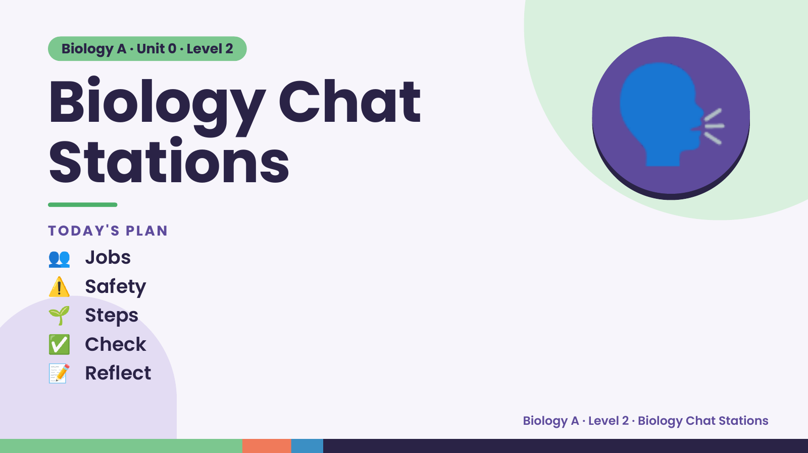
Notes:
Biology A · Unit 0 · Level 2
Biology Chat
Stations
👥 Jobs
TODAY'S PLAN
🗣️
⚠️ Safety
🌱 Steps
✅ Check
📝 Reflect
Biology A · Level 2 · Biology Chat Stations

Slide 2
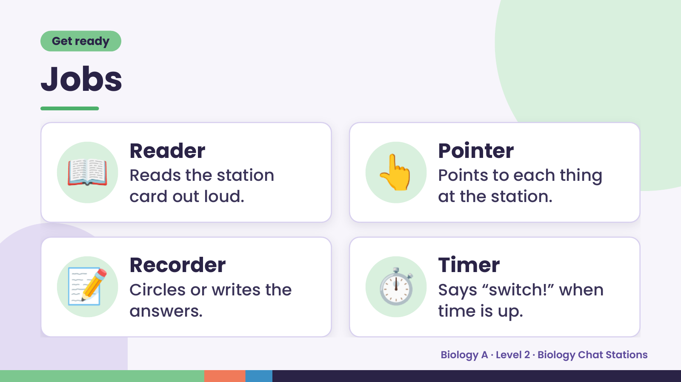
Notes:
Get ready
Jobs
📖 Reader
Reads the station
card out loud.
👆 Pointer
Points to each thing
at the station.
📝 Recorder
Circles or writes the
answers.
⏱️ Timer
Says “switch!” when
time is up.
Biology A · Level 2 · Biology Chat Stations

Slide 3
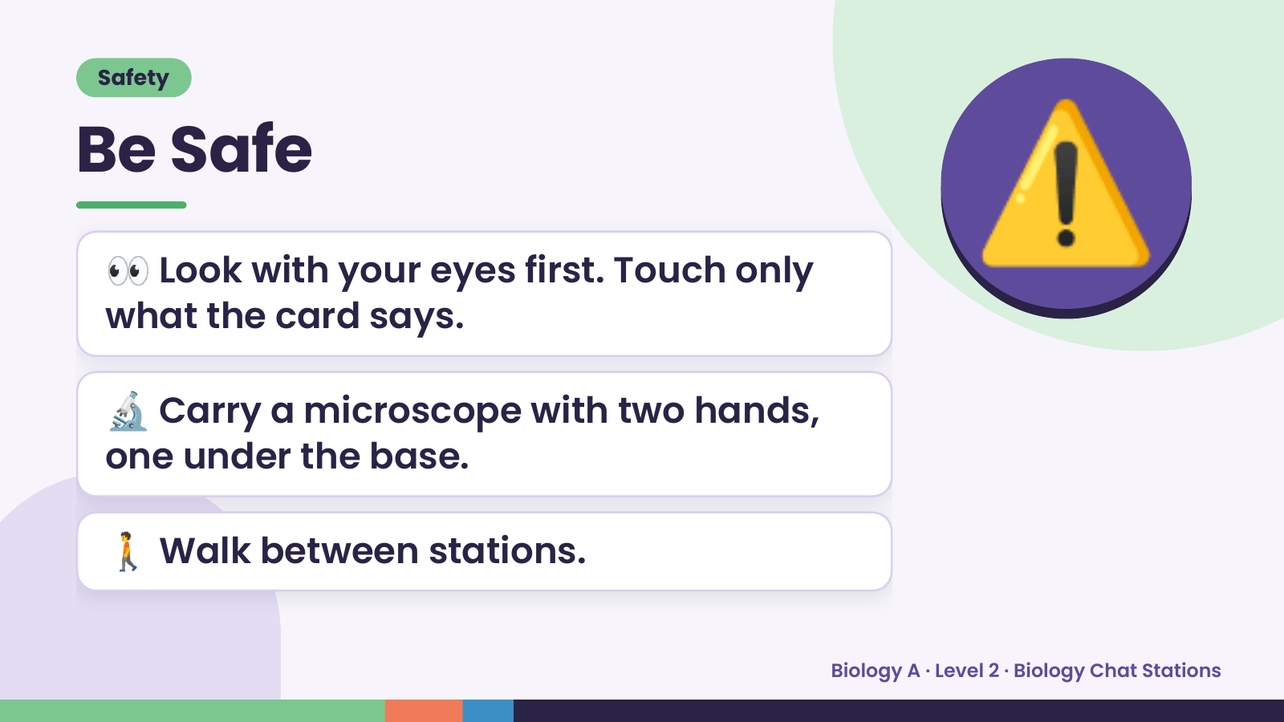
Notes:
Safety
Be Safe
👀 Look with your eyes first. Touch only
what the card says.
⚠️
🔬 Carry a microscope with two hands,
one under the base.
🚶 Walk between stations.
Biology A · Level 2 · Biology Chat Stations

Slide 4
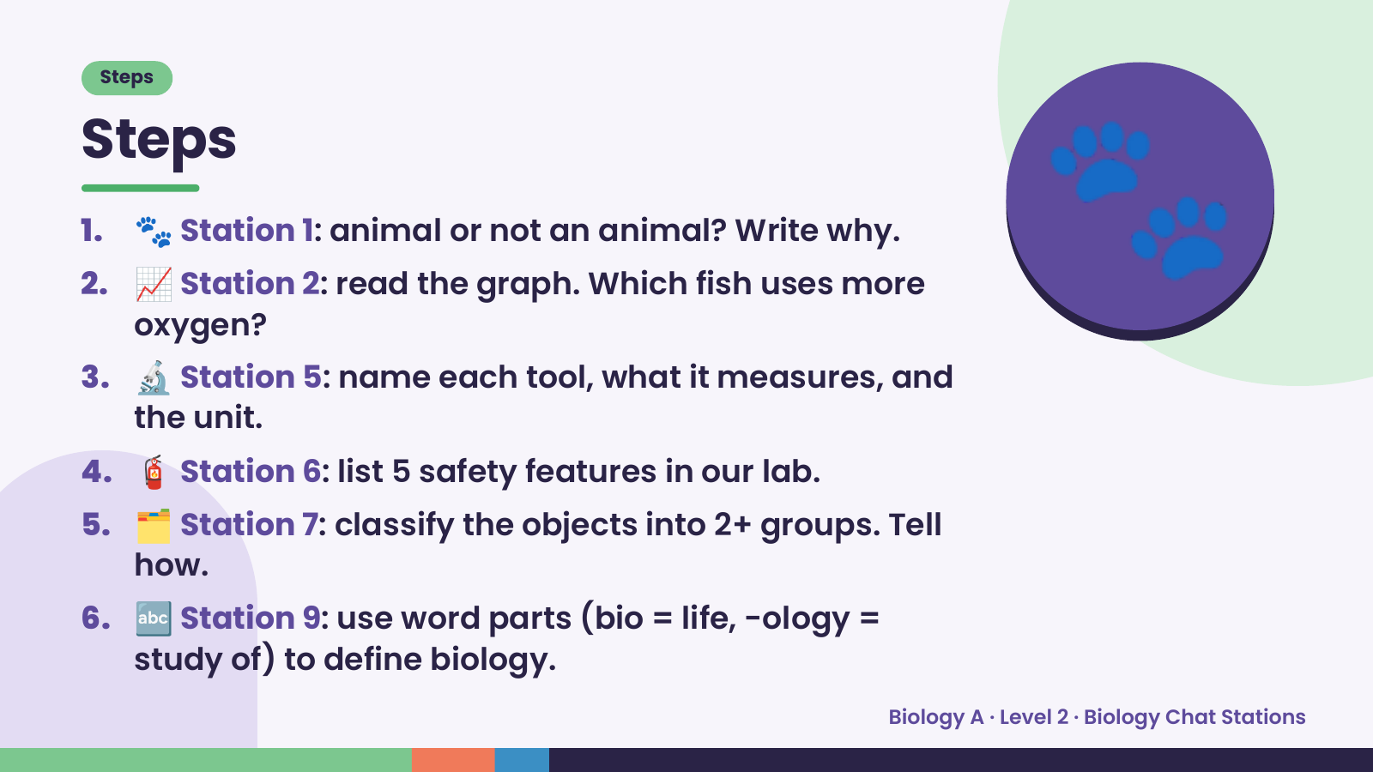
Notes:
Steps
Steps
1. 🐾 Station 1: animal or not an animal? Write why.
2. 📈 Station 2: read the graph. Which fish uses more
oxygen?
3. 🔬 Station 5: name each tool, what it measures, and
the unit.
🐾
4. 🧯 Station 6: list 5 safety features in our lab.
5. 🗂️ Station 7: classify the objects into 2+ groups. Tell
how.
6. 🔤 Station 9: use word parts (bio = life, -ology =
study of) to define biology.
Biology A · Level 2 · Biology Chat Stations

Slide 5
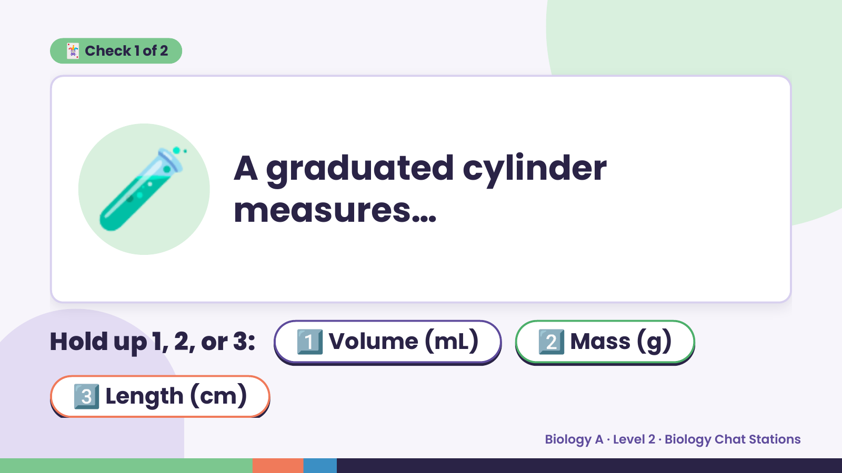
Notes:
🃏 Check 1 of 2
🧪 A graduated cylinder
measures…
Hold up 1, 2, or 3: 1️⃣ Volume (mL) 2️⃣ Mass (g)
3️⃣ Length (cm)
Biology A · Level 2 · Biology Chat Stations

Slide 6
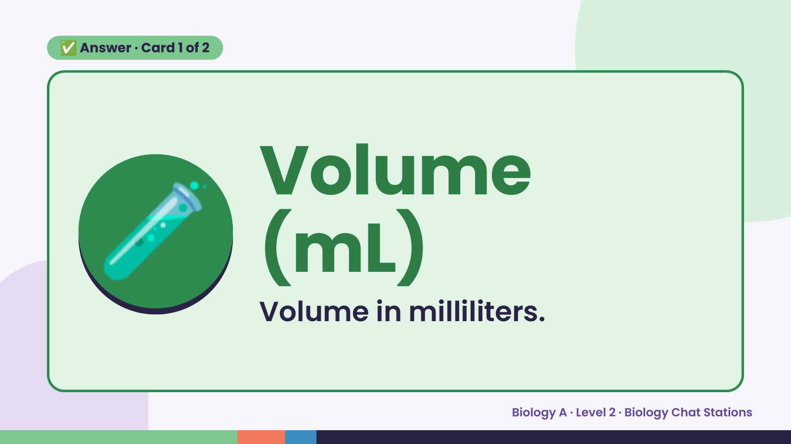
Notes:
✅ Answer · Card 1 of 2
🧪 Volume
(mL)
Volume in milliliters.
Biology A · Level 2 · Biology Chat Stations

Slide 7
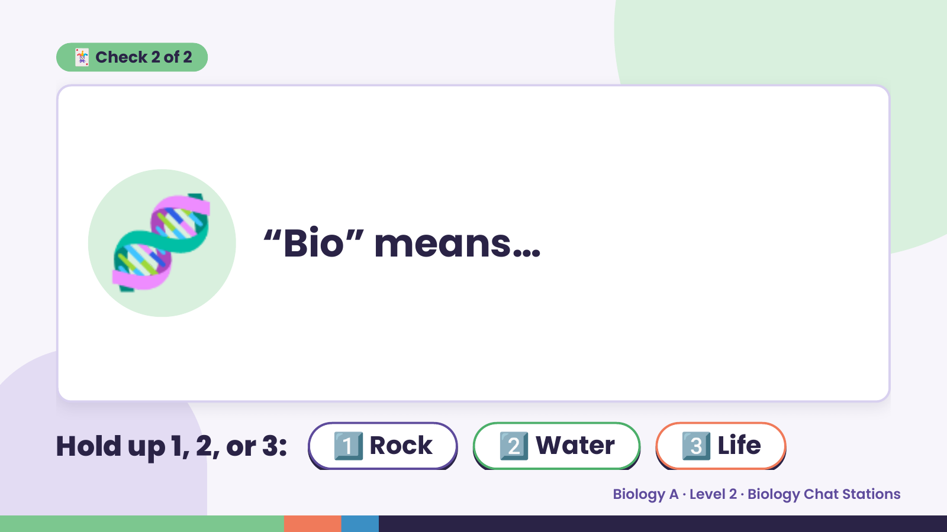
Notes:
🃏 Check 2 of 2
🧬 “Bio” means…
Hold up 1, 2, or 3: 1️⃣ Rock 2️⃣ Water 3️⃣ Life
Biology A · Level 2 · Biology Chat Stations

Slide 8
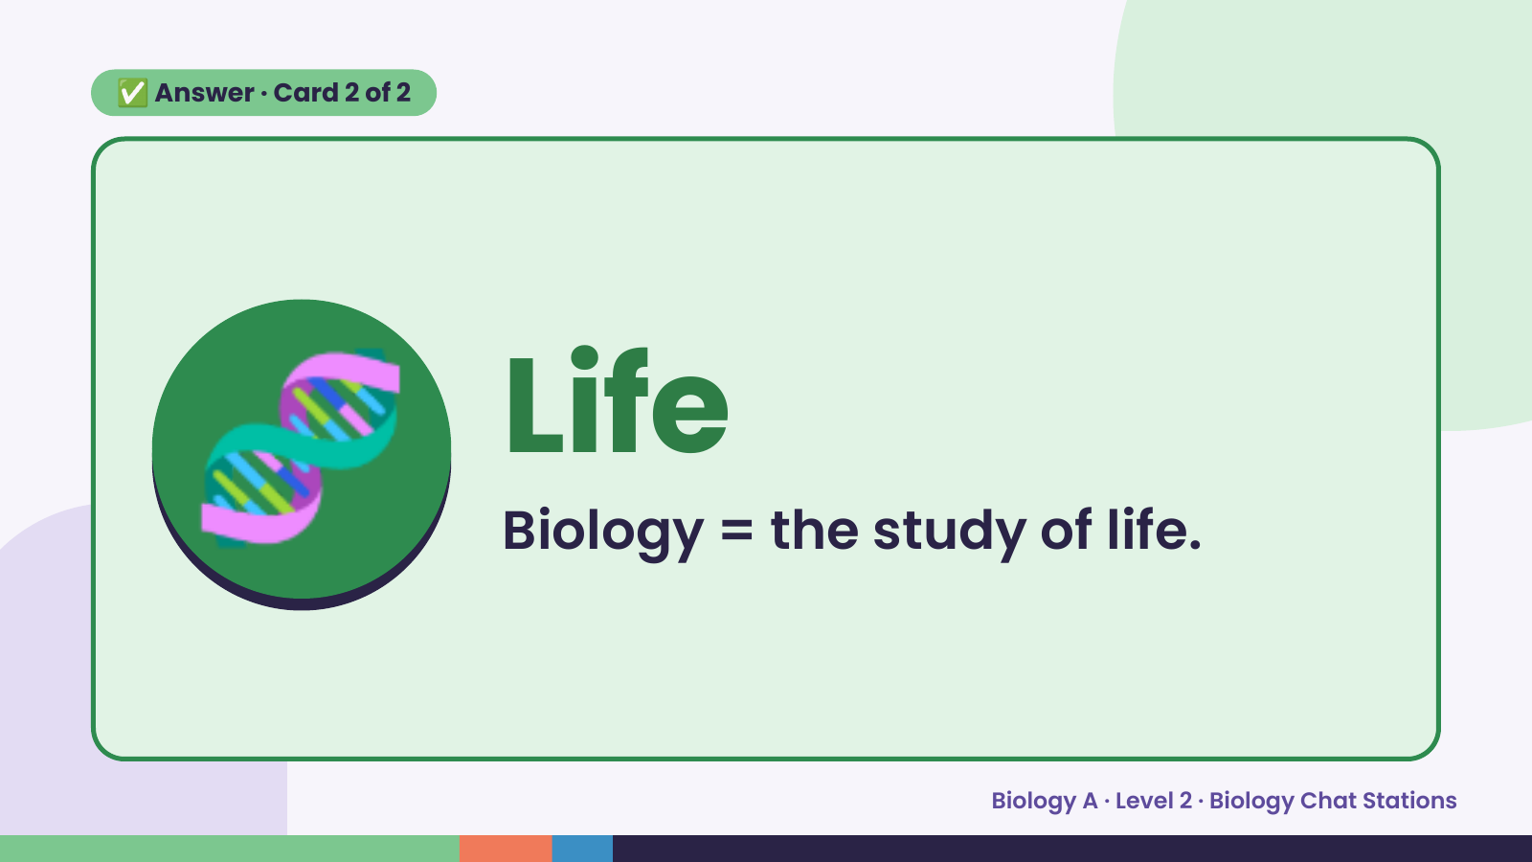
Notes:
✅ Answer · Card 2 of 2
🧬 Life
Biology = the study of life.
Biology A · Level 2 · Biology Chat Stations

Slide 9
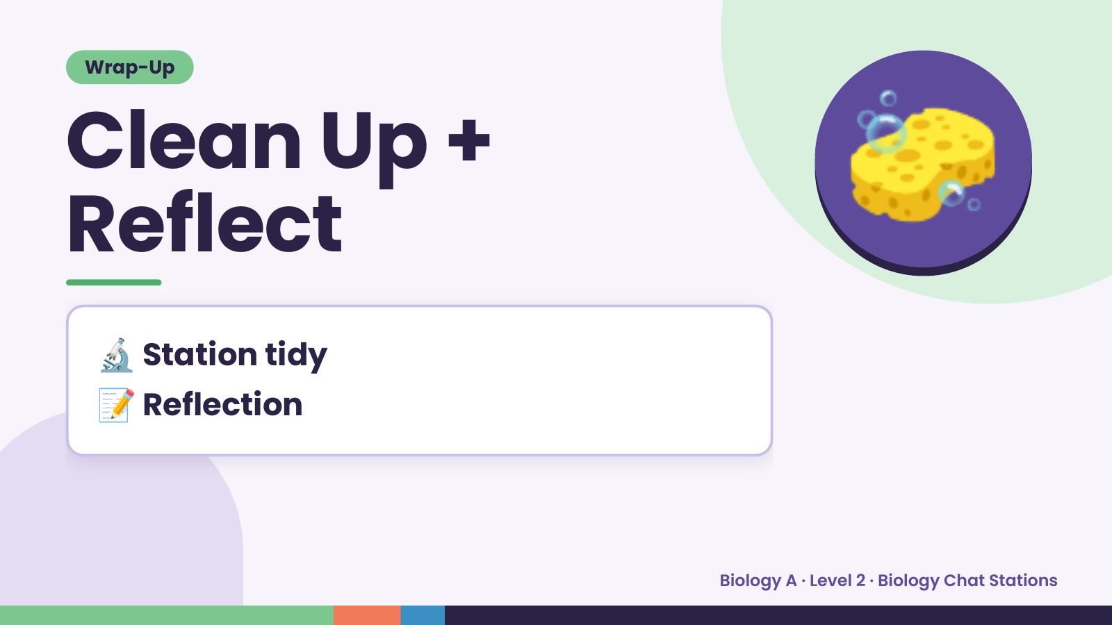
Notes:
Wrap-Up
Clean Up +
Reflect
🧽
🔬 Station tidy
📝 Reflection
Biology A · Level 2 · Biology Chat Stations

