Slide 1
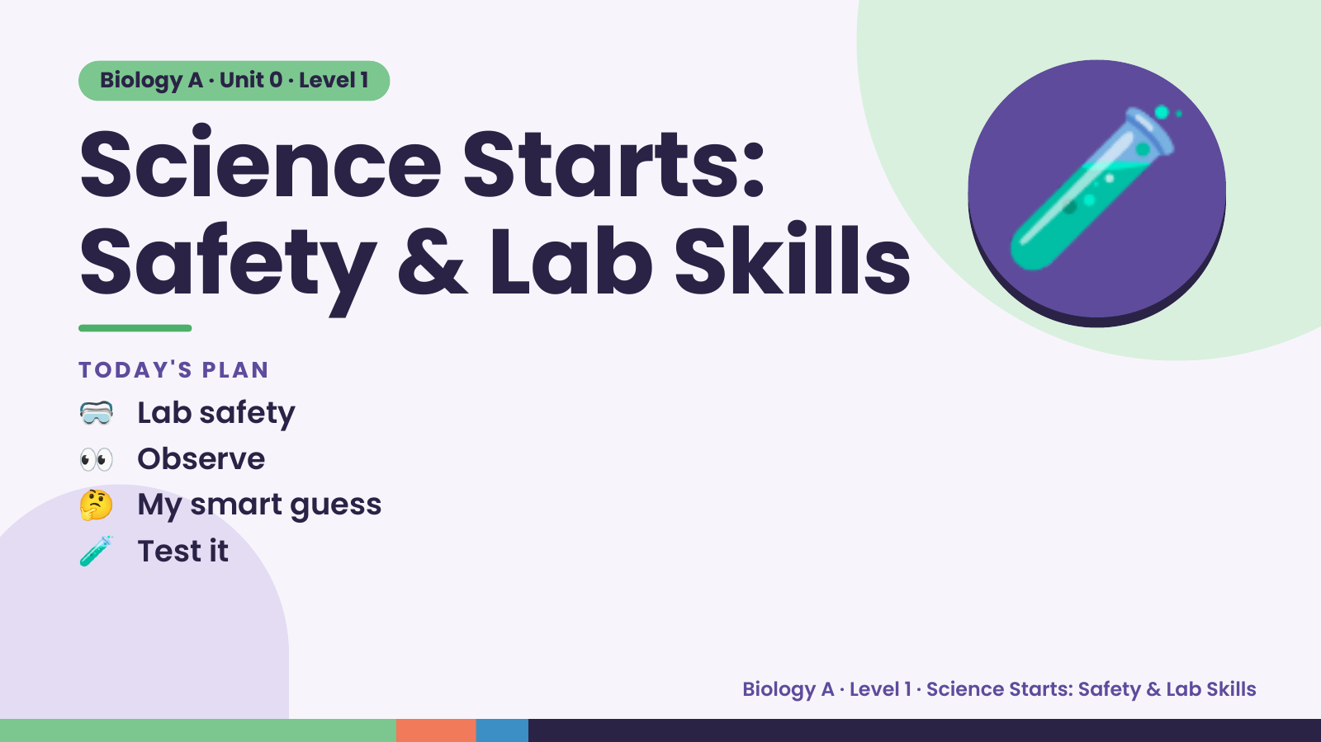
Notes:
Biology A · Unit 0 · Level 1
Science Starts:
Safety & Lab Skills
🥽 Lab safety
TODAY'S PLAN
🧪
👀 Observe
🤔 My smart guess
🧪 Test it
Biology A · Level 1 · Science Starts: Safety & Lab Skills

Slide 2
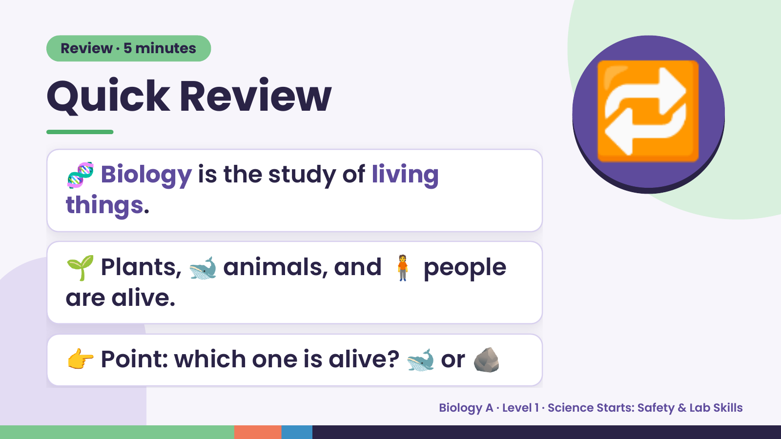
Notes:
Review · 5 minutes
Quick Review
🧬 Biology is the study of living
things.
🔁
🌱 Plants, 🐋 animals, and 🧍 people
are alive.
👉 Point: which one is alive? 🐋 or 🪨
Biology A · Level 1 · Science Starts: Safety & Lab Skills

Slide 3
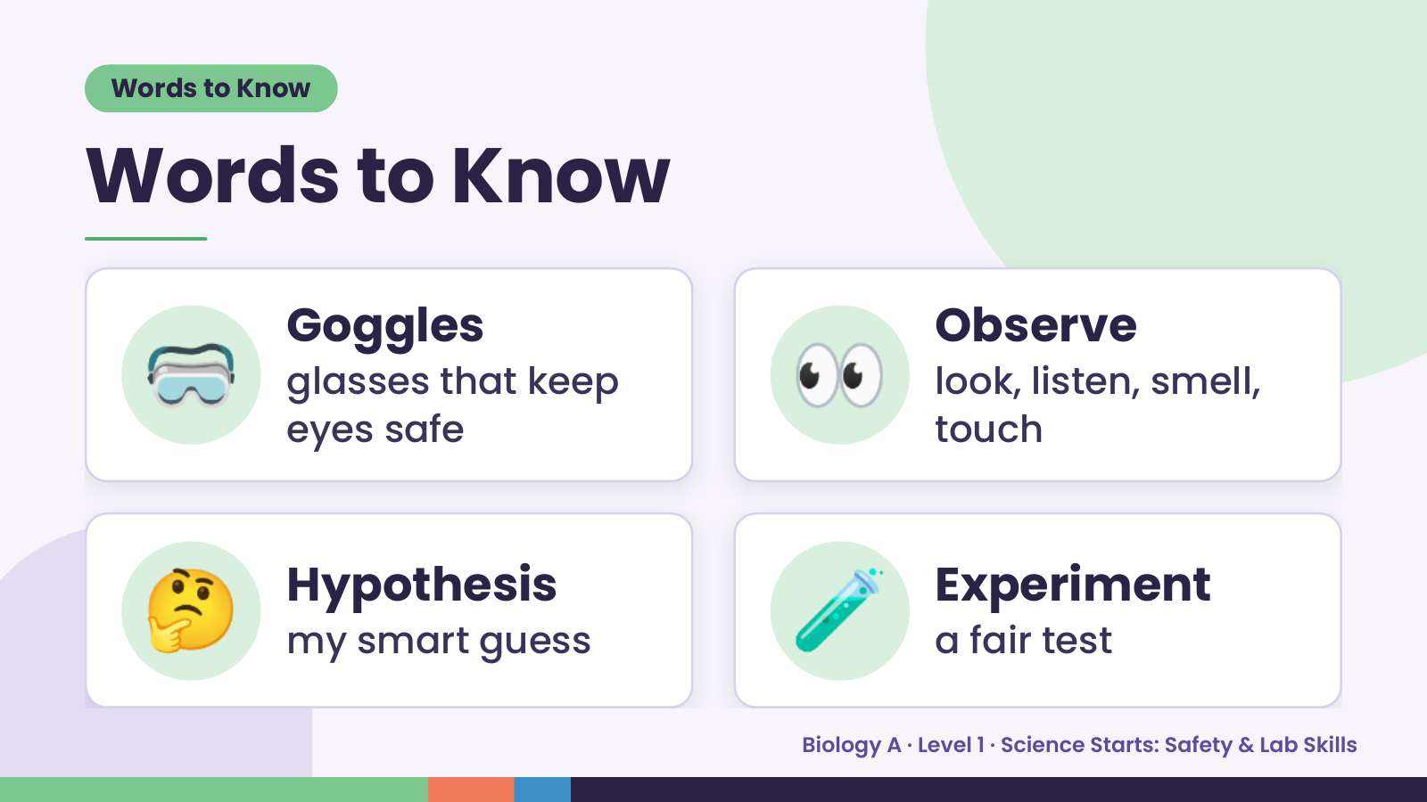
Notes:
Words to Know
Words to Know
🥽 Goggles
glasses that keep
eyes safe
👀 Observe
look, listen, smell,
touch
🤔 Hypothesis
my smart guess 🧪 Experiment
a fair test
Biology A · Level 1 · Science Starts: Safety & Lab Skills

Slide 4
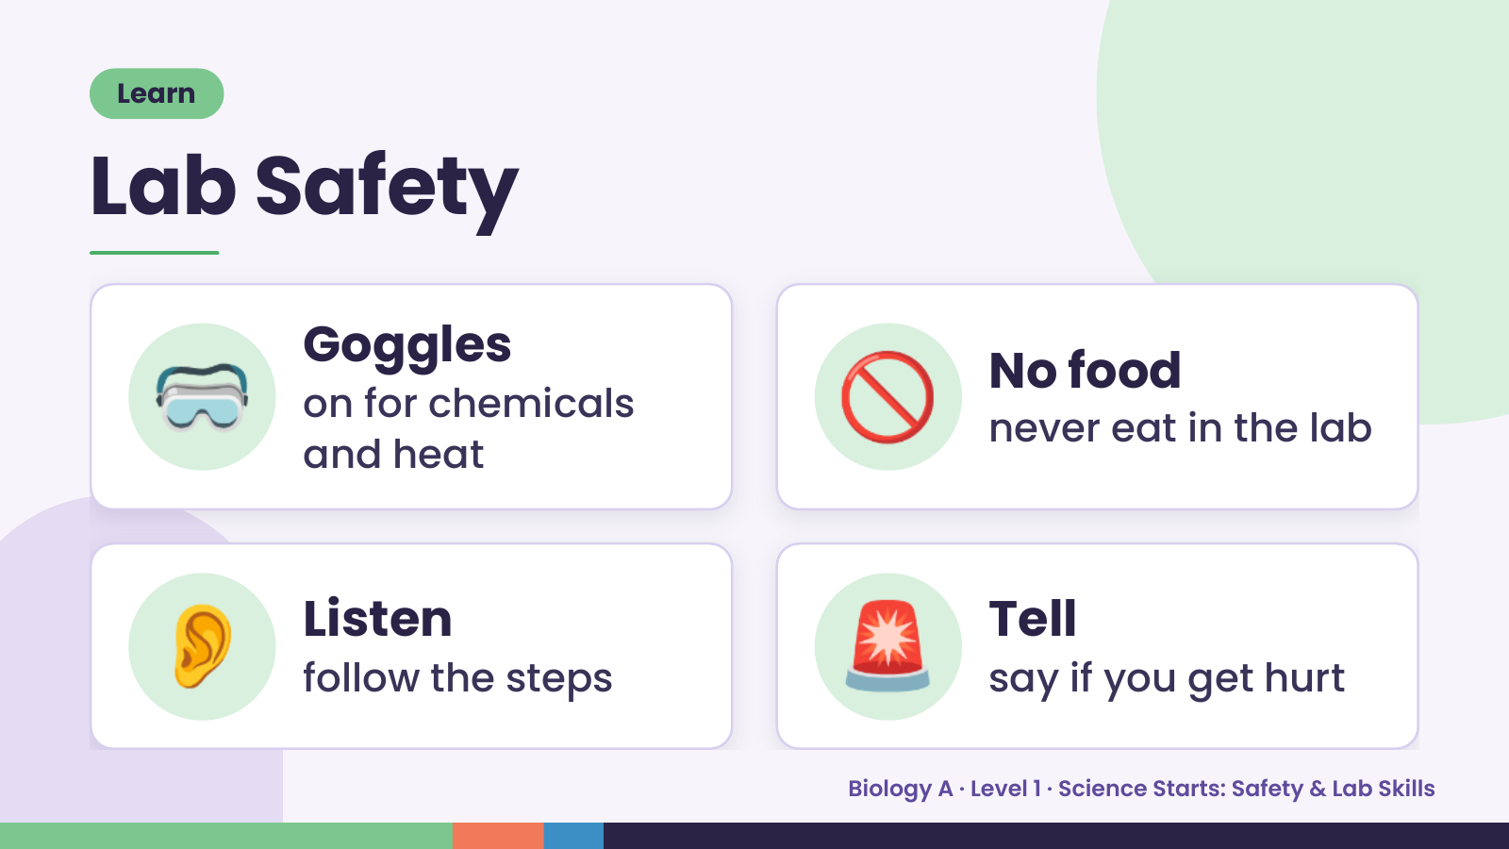
Notes:
Learn
Lab Safety
🥽 Goggles
on for chemicals
and heat
🚫 No food
never eat in the lab
👂 Listen
follow the steps 🚨 Tell
say if you get hurt
Biology A · Level 1 · Science Starts: Safety & Lab Skills

Slide 5
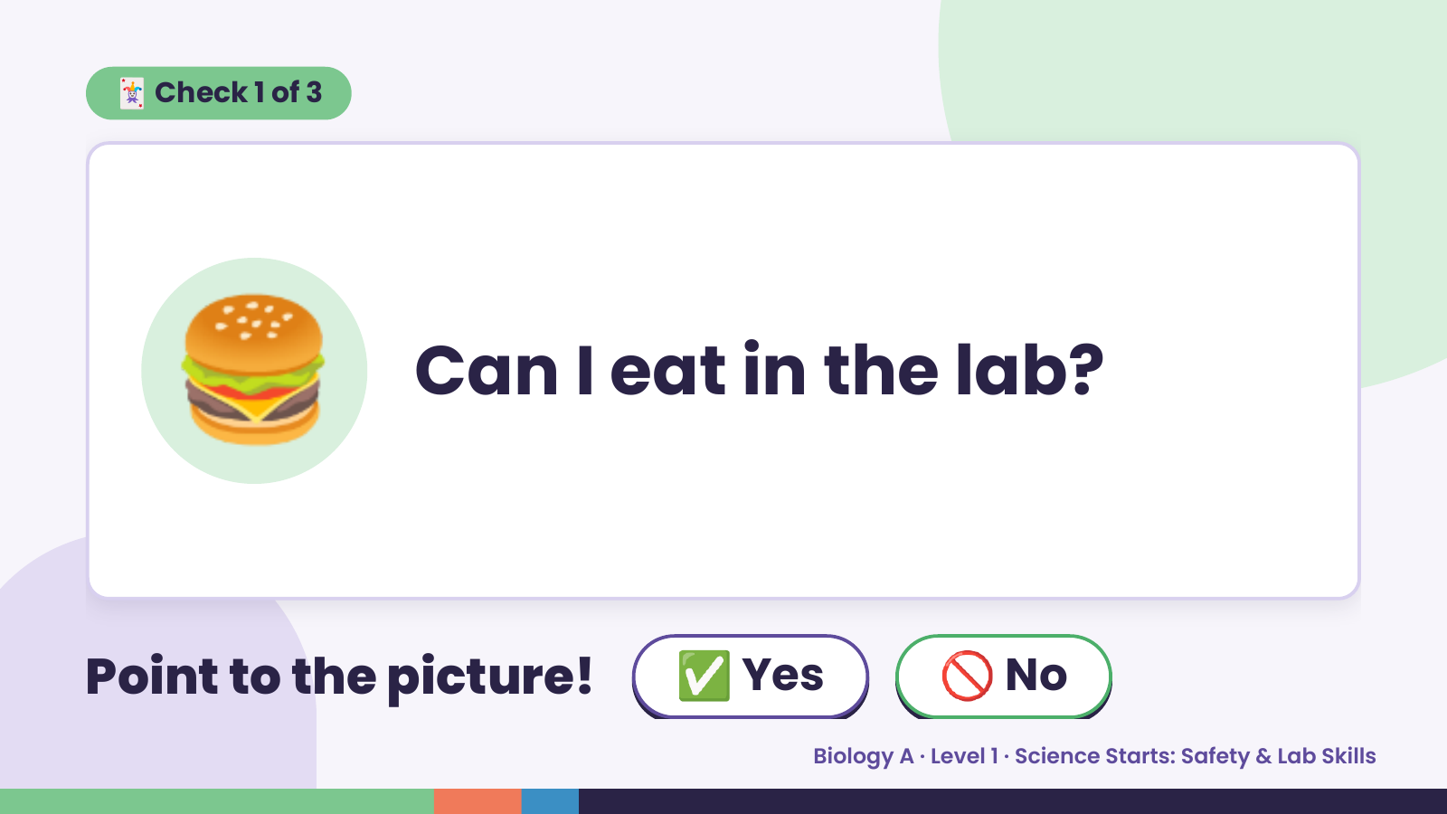
Notes:
🃏 Check 1 of 3
🍔 Can I eat in the lab?
Point to the picture! ✅ Yes 🚫 No
Biology A · Level 1 · Science Starts: Safety & Lab Skills

Slide 6
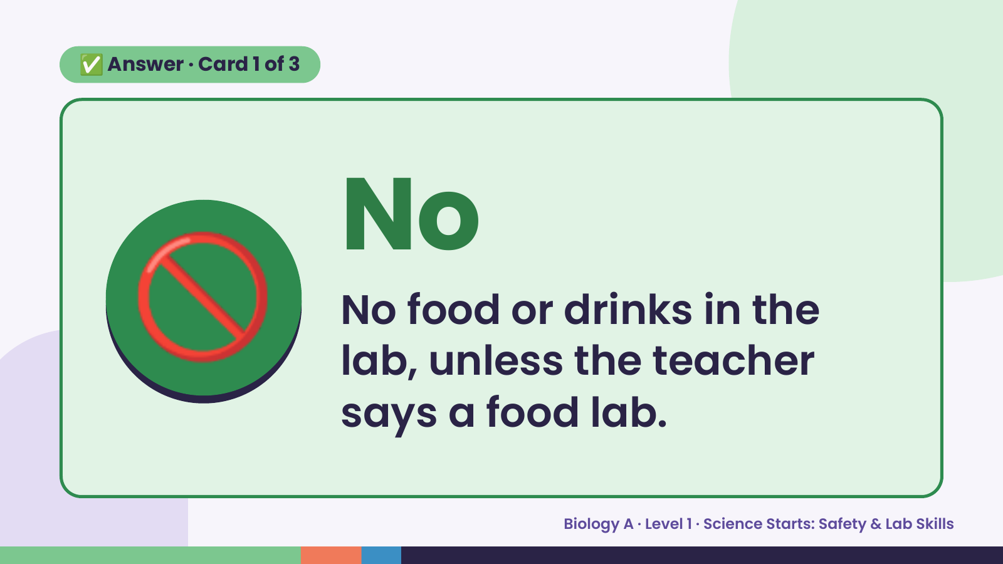
Notes:
✅ Answer · Card 1 of 3
🚫 No
No food or drinks in the
lab, unless the teacher
says a food lab.
Biology A · Level 1 · Science Starts: Safety & Lab Skills

Slide 7
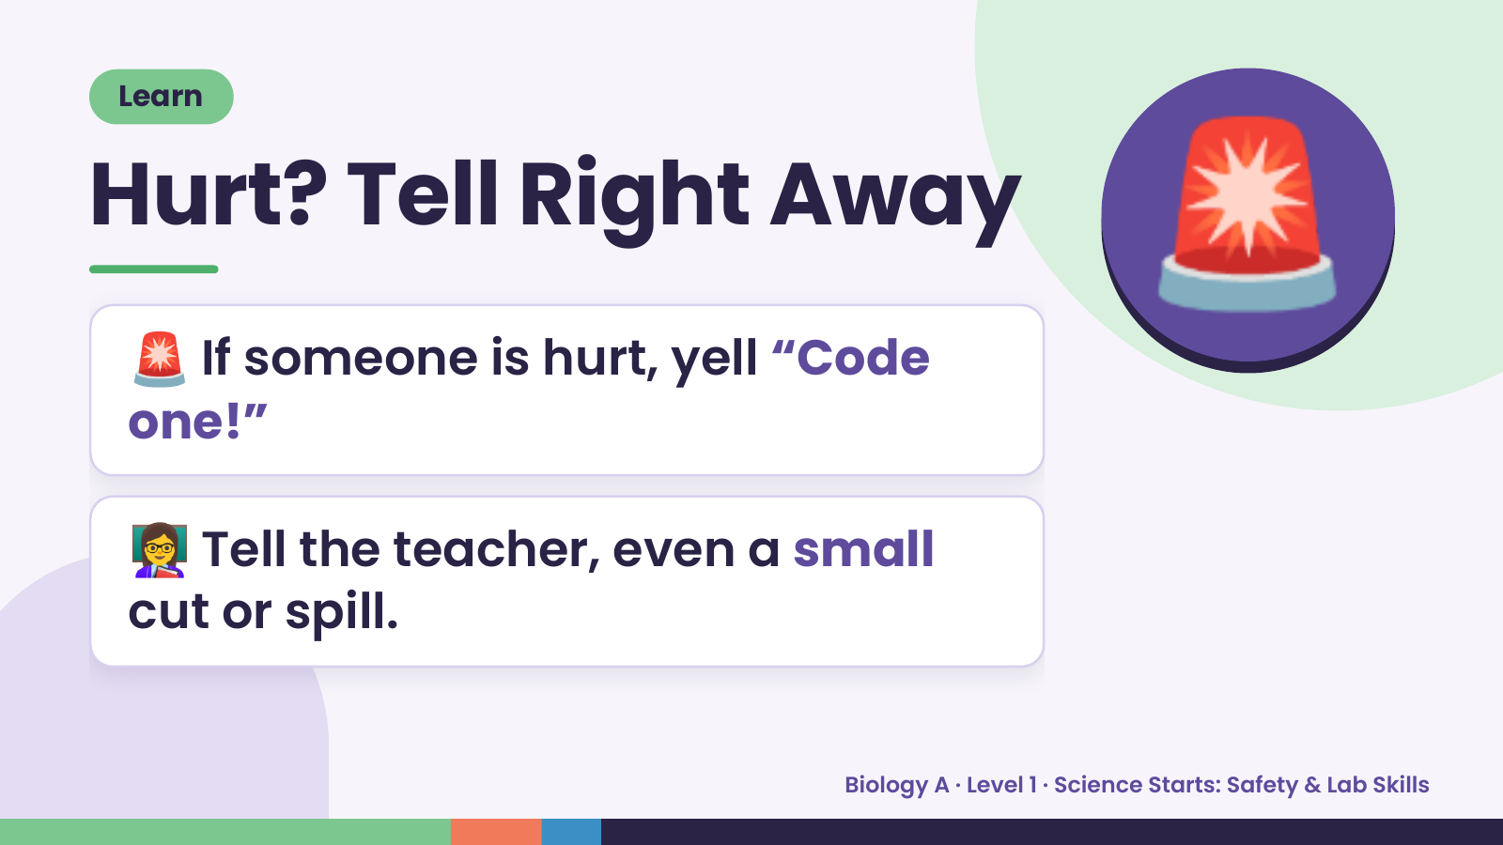
Notes:
Learn
Hurt? Tell Right Away
🚨 If someone is hurt, yell “Code
one!”
🚨
👩‍🏫 Tell the teacher, even a small
cut or spill.
Biology A · Level 1 · Science Starts: Safety & Lab Skills

Slide 8
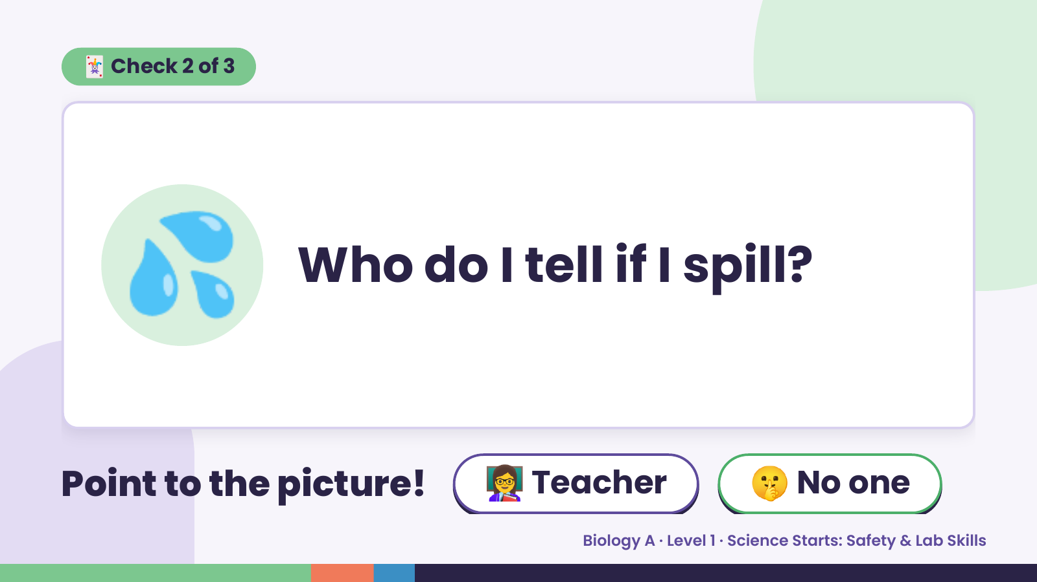
Notes:
🃏 Check 2 of 3
💦 Who do I tell if I spill?
Point to the picture! 👩‍🏫 Teacher 🤫 No one
Biology A · Level 1 · Science Starts: Safety & Lab Skills

Slide 9
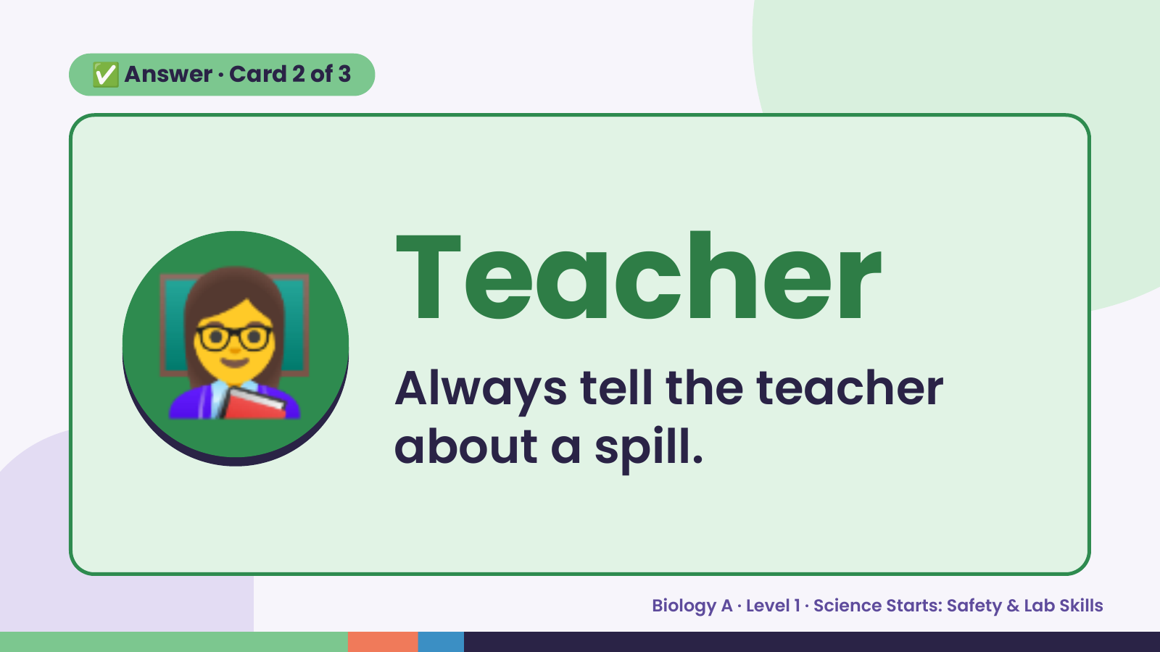
Notes:
✅ Answer · Card 2 of 3
👩‍🏫 Teacher
Always tell the teacher
about a spill.
Biology A · Level 1 · Science Starts: Safety & Lab Skills

Slide 10
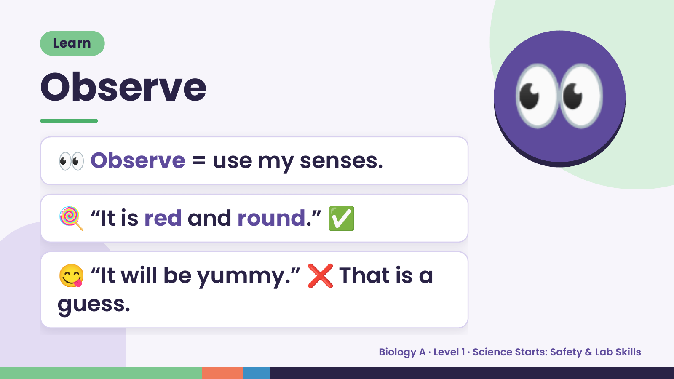
Notes:
Learn
Observe
👀 Observe = use my senses.
👀
🍭 “It is red and round.” ✅
😋 “It will be yummy.” ❌ That is a
guess.
Biology A · Level 1 · Science Starts: Safety & Lab Skills

Slide 11
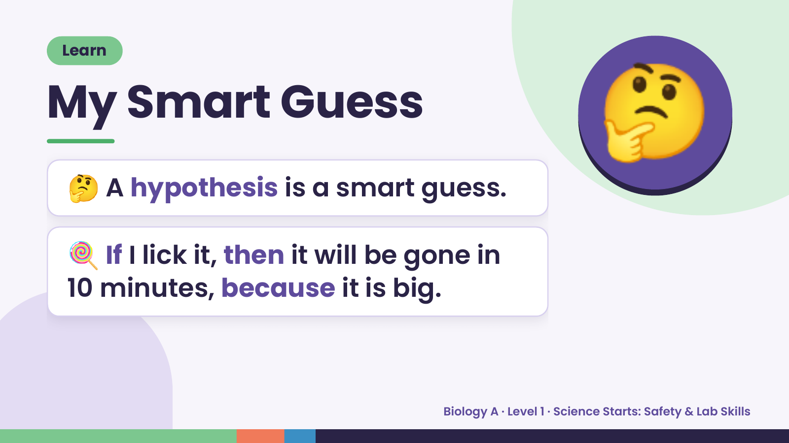
Notes:
Learn
My Smart Guess
🤔 A hypothesis is a smart guess.
🤔
🍭 If I lick it, then it will be gone in
10 minutes, because it is big.
Biology A · Level 1 · Science Starts: Safety & Lab Skills

Slide 12
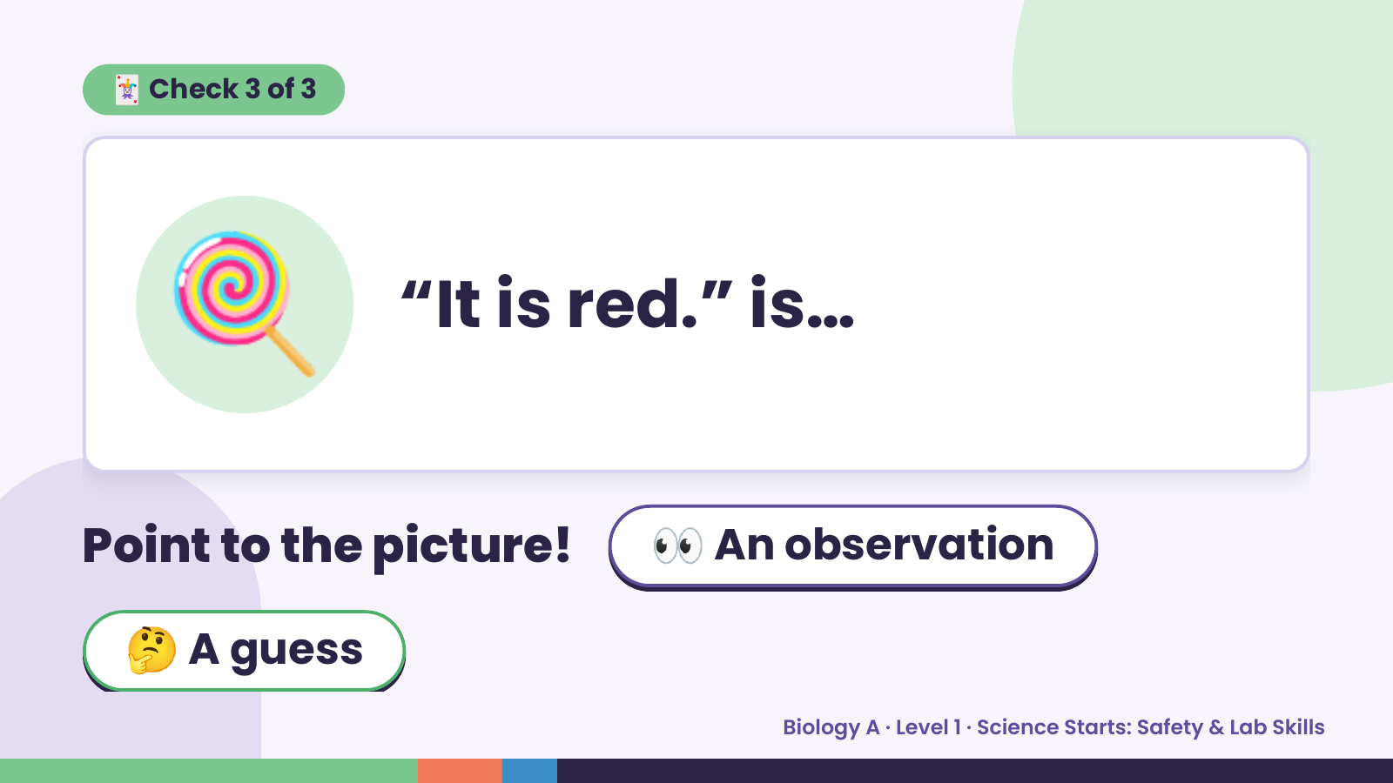
Notes:
🃏 Check 3 of 3
🍭 “It is red.” is…
Point to the picture! 👀 An observation
🤔 A guess
Biology A · Level 1 · Science Starts: Safety & Lab Skills

Slide 13
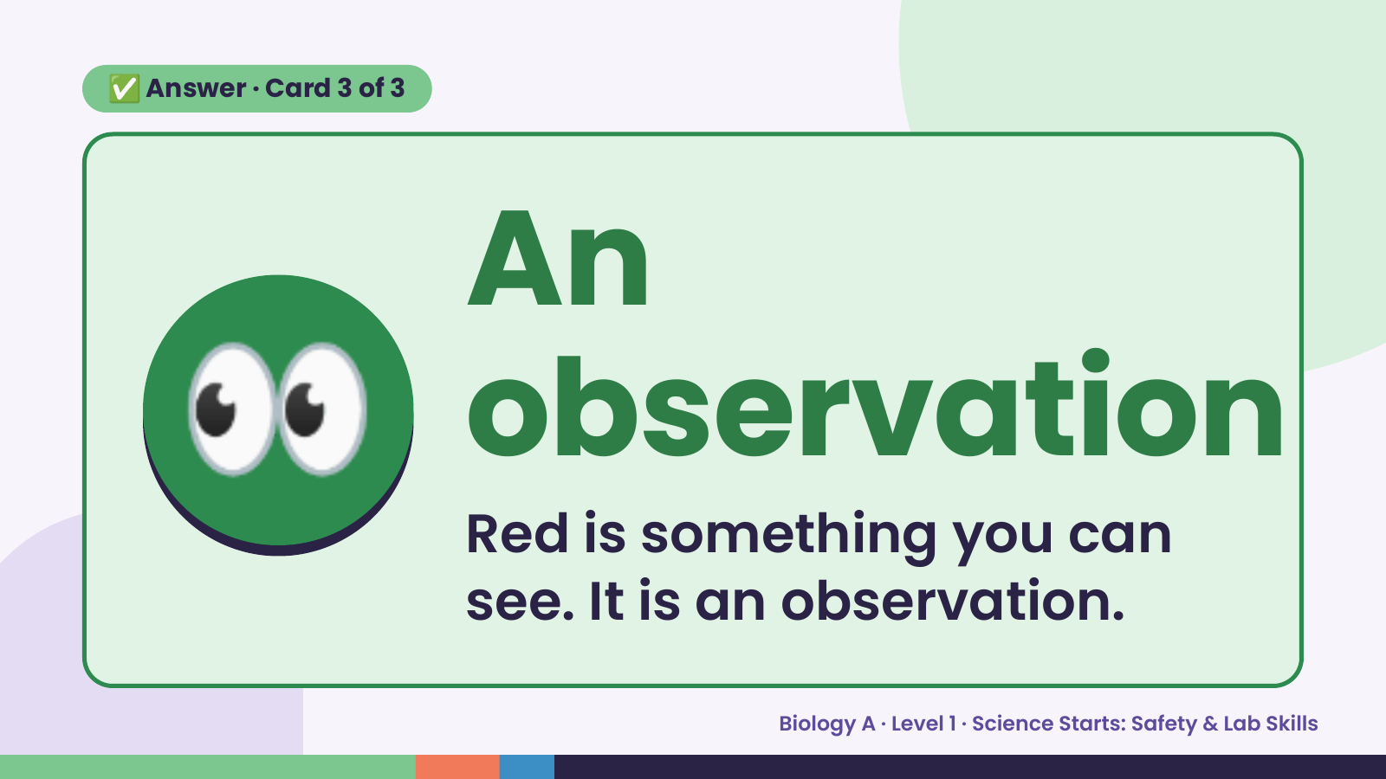
Notes:
✅ Answer · Card 3 of 3
👀 An
observation
Red is something you can
see. It is an observation.
Biology A · Level 1 · Science Starts: Safety & Lab Skills

Slide 14
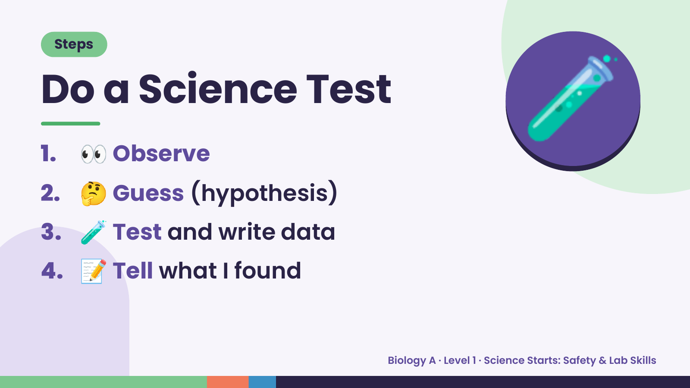
Notes:
Steps
Do a Science Test
1. 👀 Observe
2. 🤔 Guess (hypothesis)
🧪
3. 🧪 Test and write data
4. 📝 Tell what I found
Biology A · Level 1 · Science Starts: Safety & Lab Skills

Slide 15
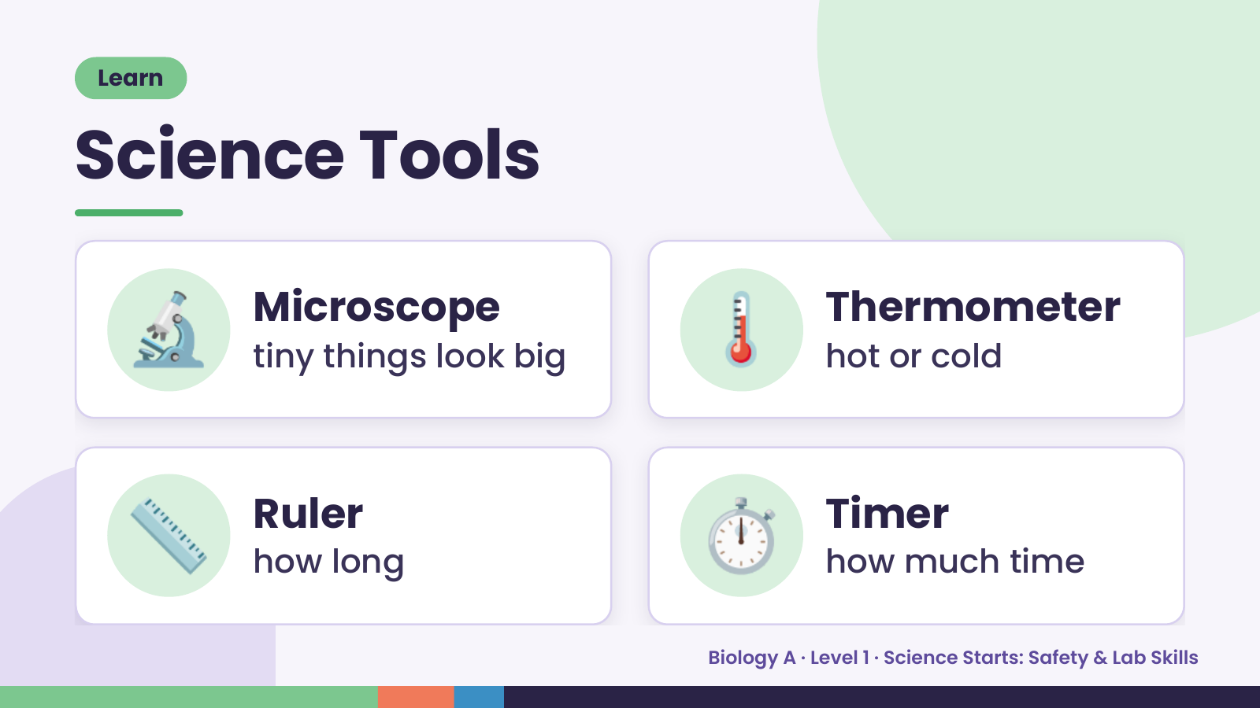
Notes:
Learn
Science Tools
🔬 Microscope
tiny things look big 🌡️ Thermometer
hot or cold
📏 Ruler
how long ⏱️ Timer
how much time
Biology A · Level 1 · Science Starts: Safety & Lab Skills

Slide 16
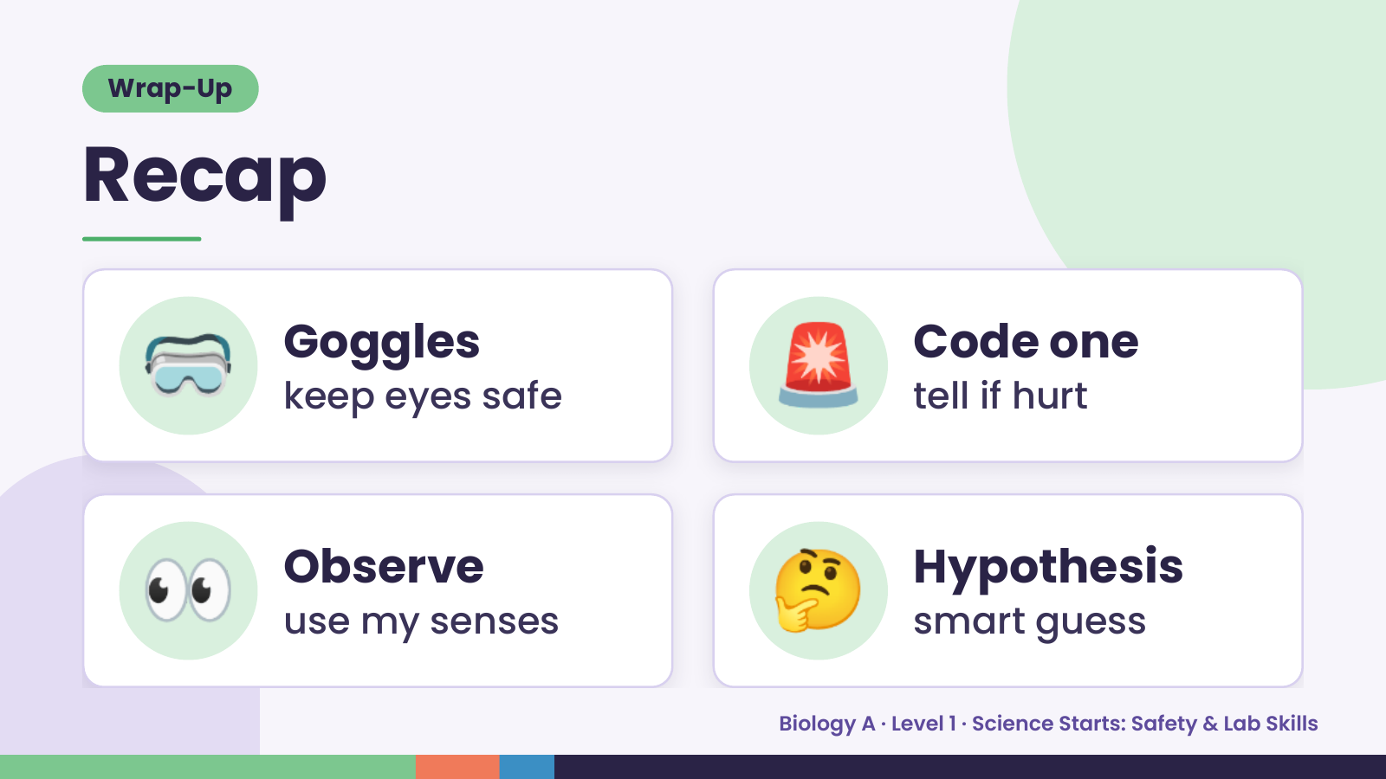
Notes:
Wrap-Up
Recap
🥽 Goggles
keep eyes safe 🚨 Code one
tell if hurt
👀 Observe
use my senses 🤔 Hypothesis
smart guess
Biology A · Level 1 · Science Starts: Safety & Lab Skills

Slide 17
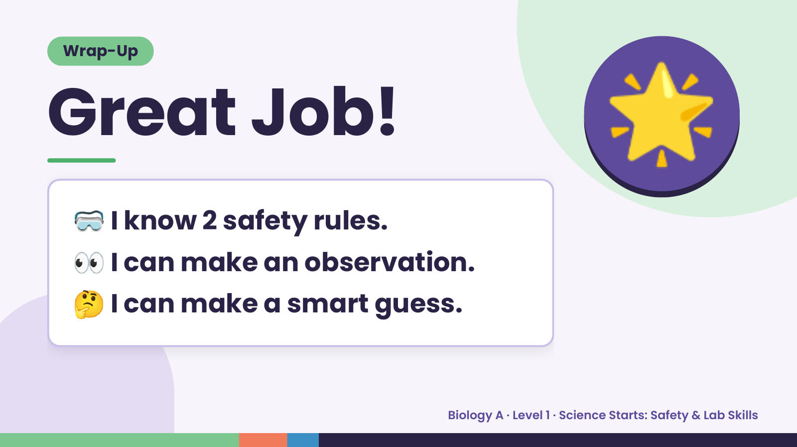
Notes:
Wrap-Up
Great Job!
🥽 I know 2 safety rules.
🌟
👀 I can make an observation.
🤔 I can make a smart guess.
Biology A · Level 1 · Science Starts: Safety & Lab Skills

