Slide 1
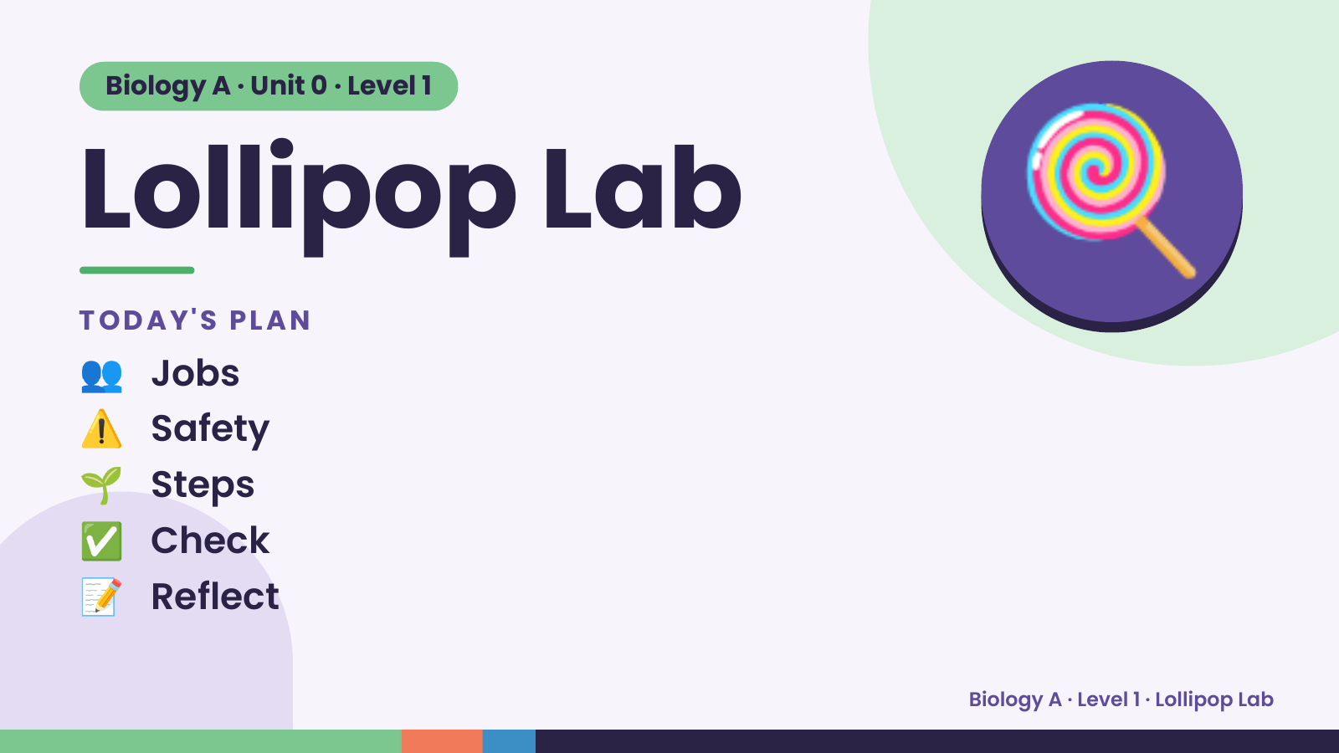
Notes:
Biology A · Unit 0 · Level 1
Lollipop Lab
TODAY'S PLAN
👥 Jobs
🍭
⚠️ Safety
🌱 Steps
✅ Check
📝 Reflect
Biology A · Level 1 · Lollipop Lab

Slide 2
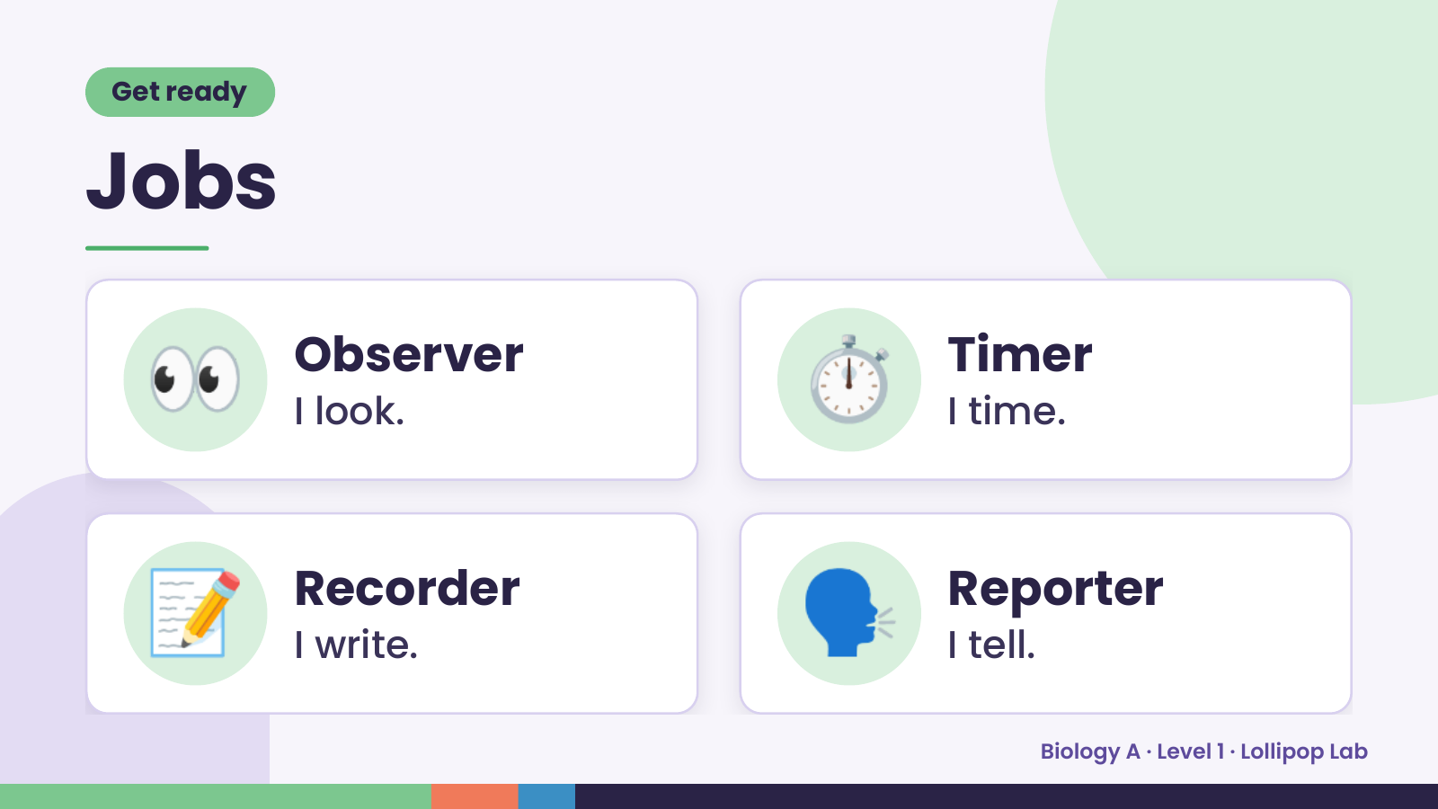
Notes:
Get ready
Jobs
👀 Observer
I look. ⏱️ Timer
I time.
📝 Recorder
I write. 🗣️ Reporter
I tell.
Biology A · Level 1 · Lollipop Lab

Slide 3
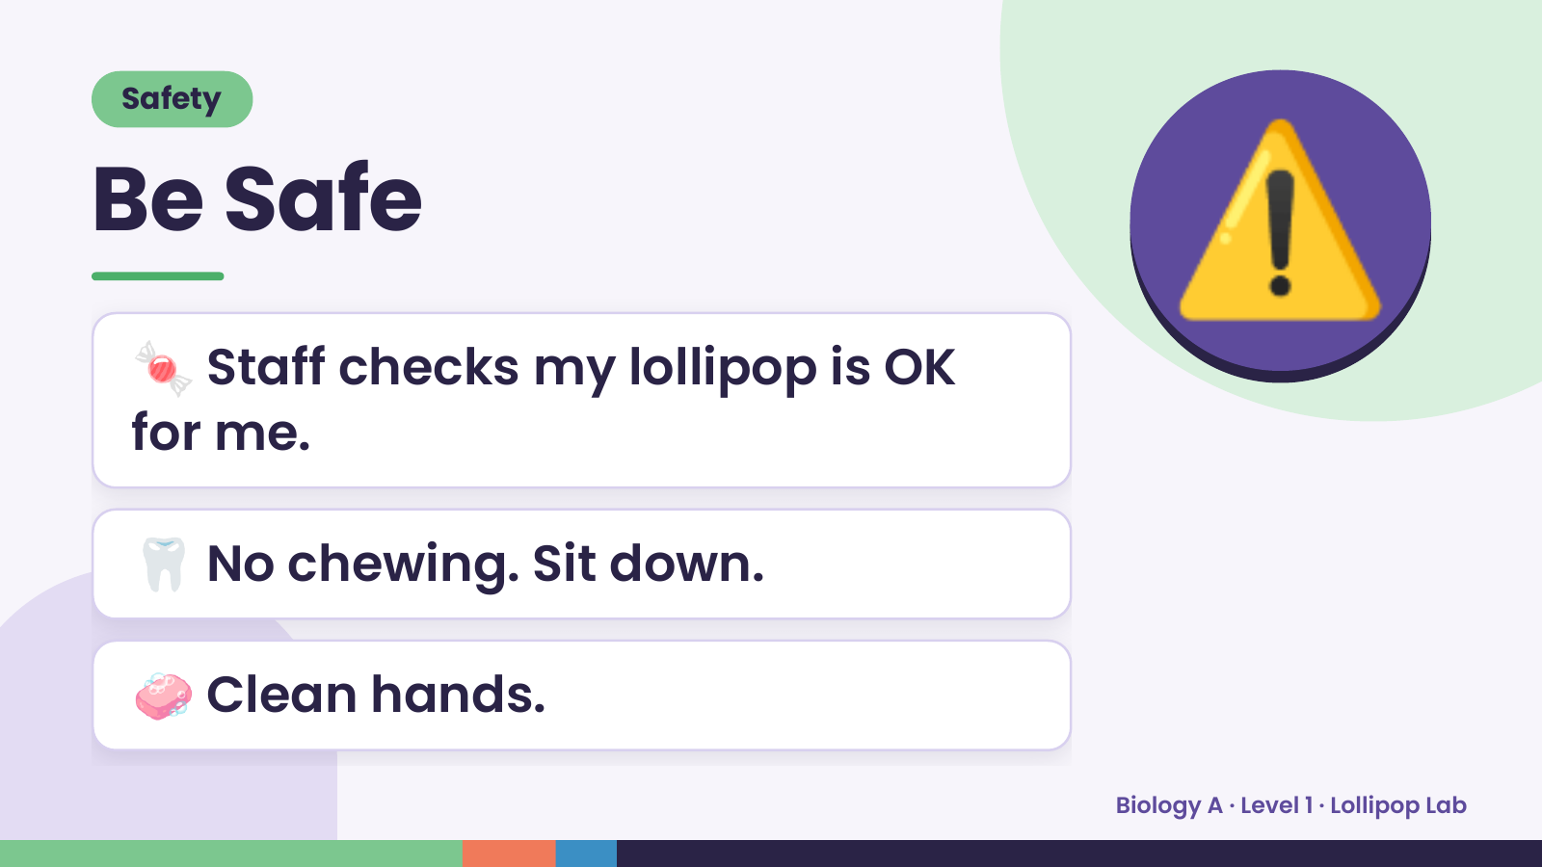
Notes:
Safety
Be Safe
🍬 Staff checks my lollipop is OK
for me.
⚠️
🦷 No chewing. Sit down.
🧼 Clean hands.
Biology A · Level 1 · Lollipop Lab

Slide 4
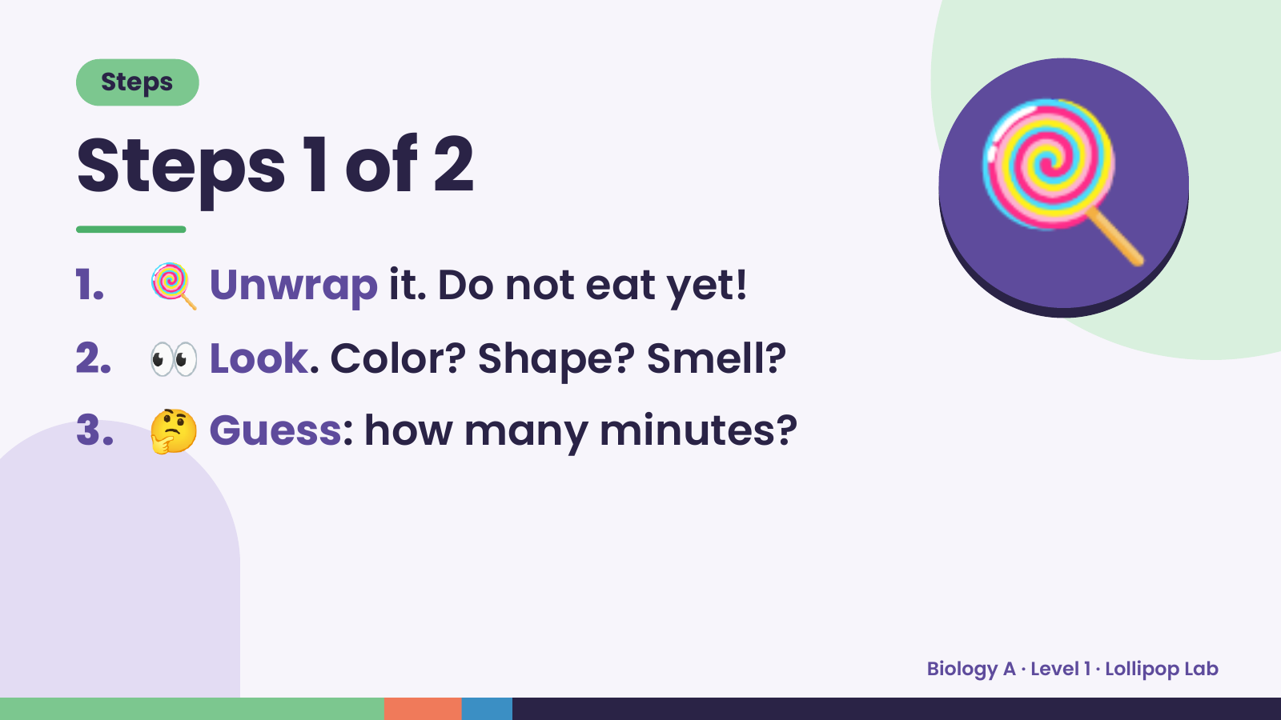
Notes:
Steps
Steps 1 of 2
1. 🍭 Unwrap it. Do not eat yet!
2. 👀 Look. Color? Shape? Smell?
🍭
3. 🤔 Guess: how many minutes?
Biology A · Level 1 · Lollipop Lab

Slide 5
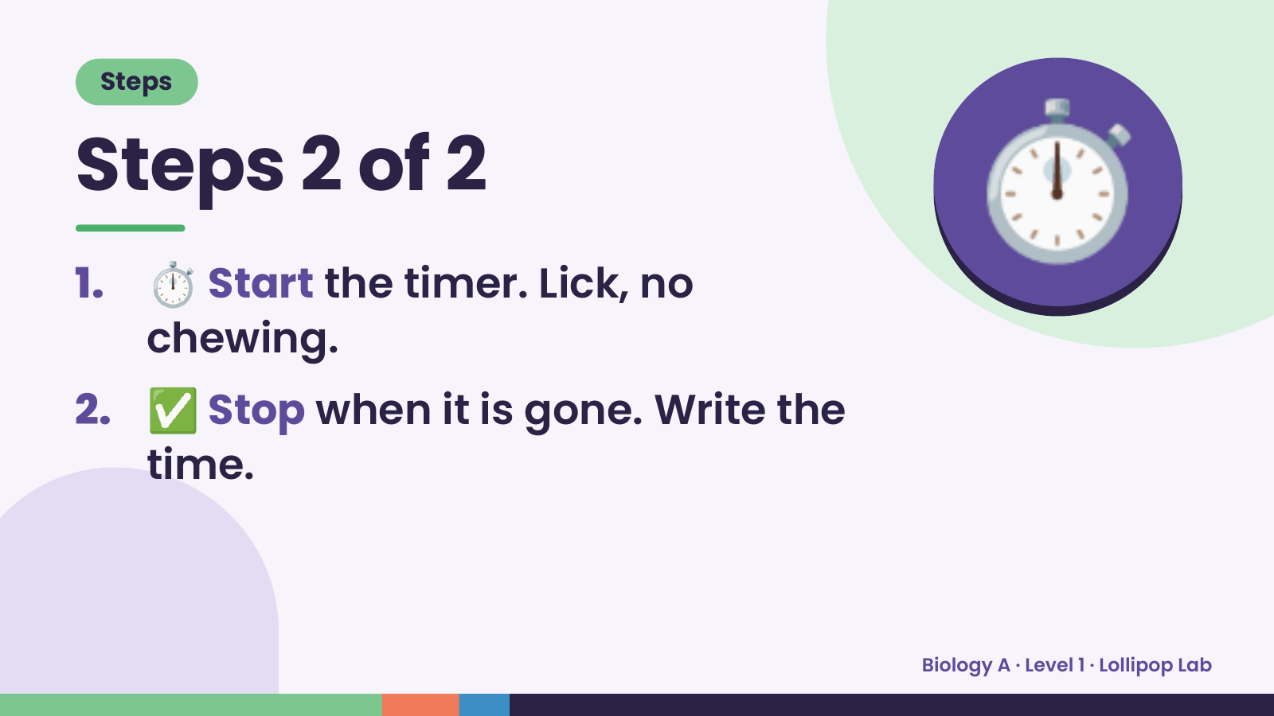
Notes:
Steps
Steps 2 of 2
1. ⏱️ Start the timer. Lick, no
chewing.
⏱️
2. ✅ Stop when it is gone. Write the
time.
Biology A · Level 1 · Lollipop Lab

Slide 6
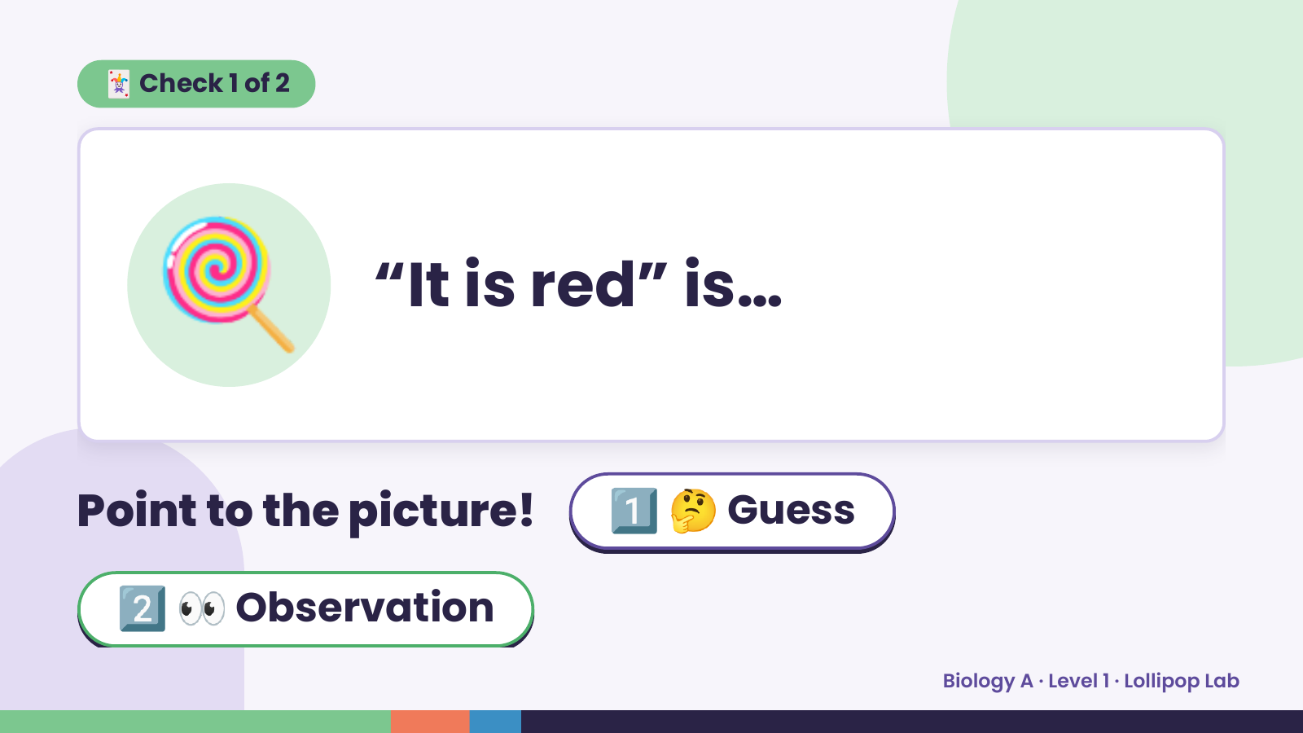
Notes:
🃏 Check 1 of 2
🍭 “It is red” is…
Point to the picture! 1️⃣ 🤔 Guess
2️⃣ 👀 Observation
Biology A · Level 1 · Lollipop Lab

Slide 7
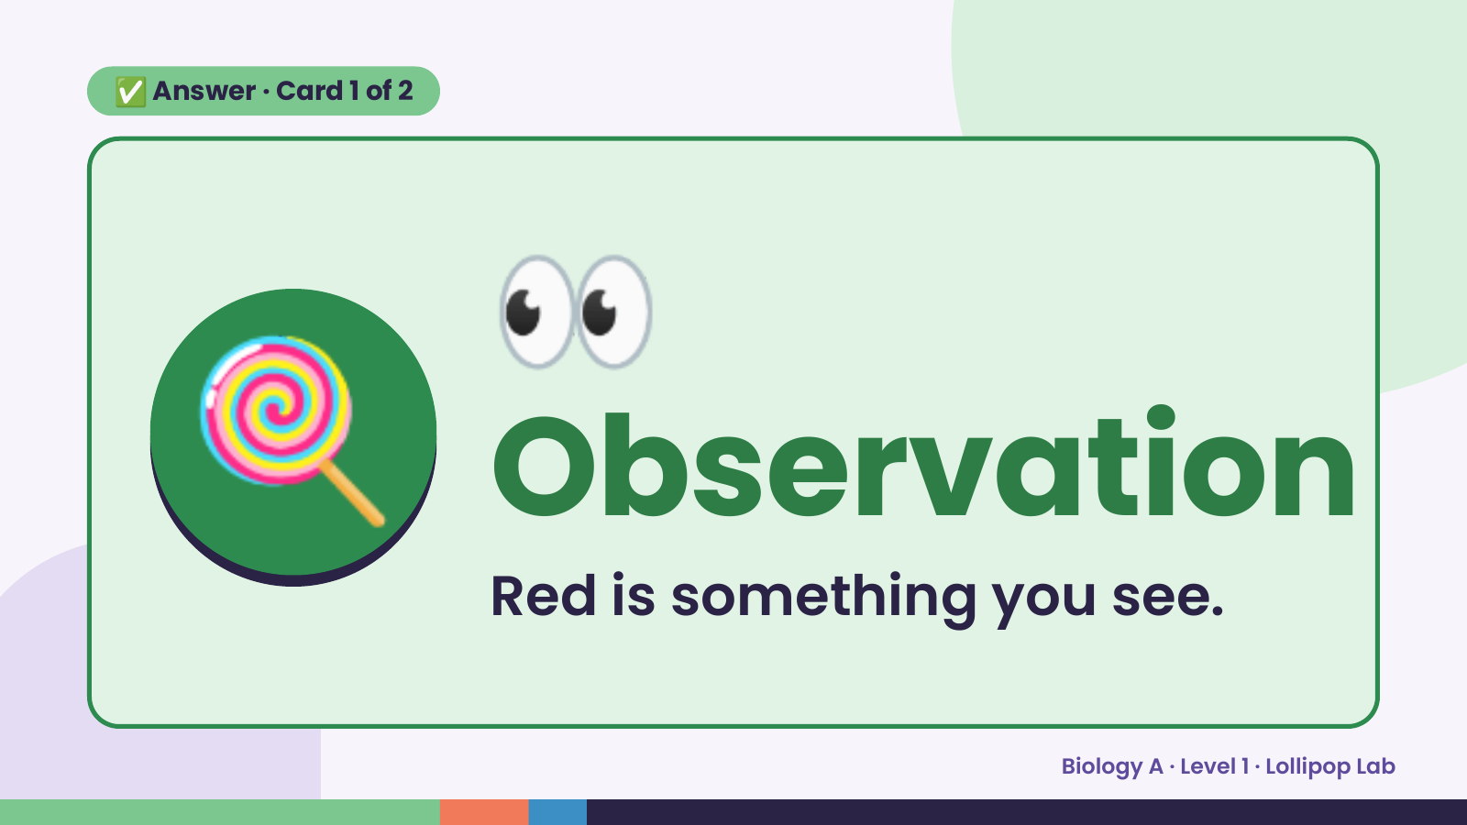
Notes:
👀
✅ Answer · Card 1 of 2
🍭 Observation Red is something you see.
Biology A · Level 1 · Lollipop Lab

Slide 8
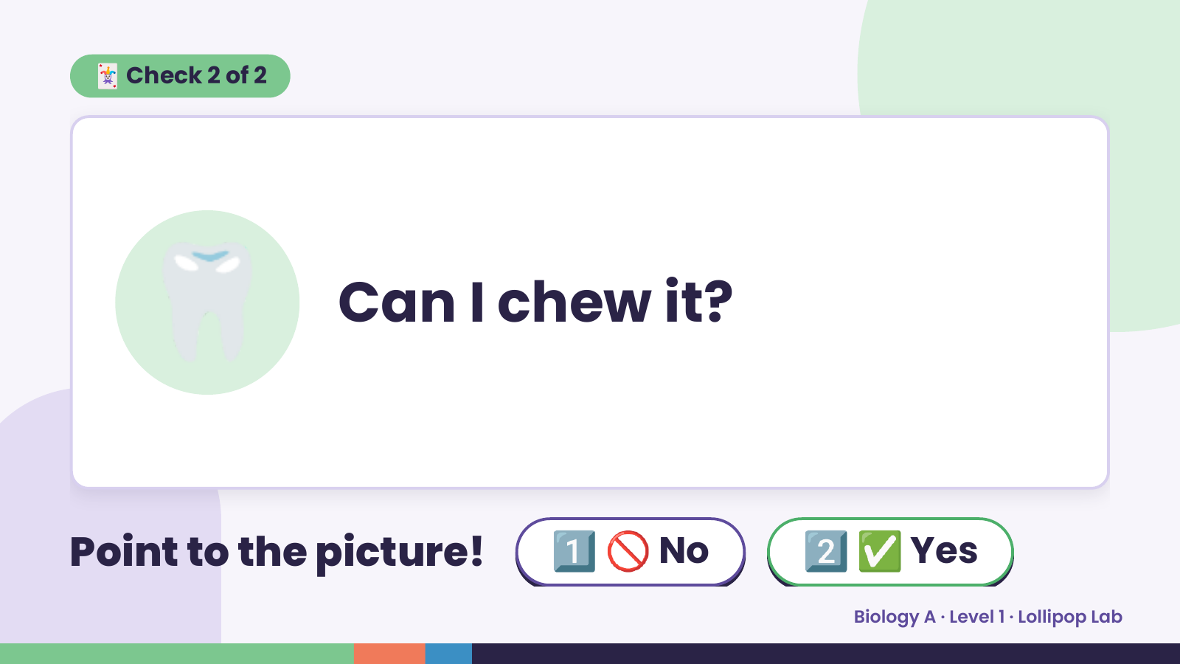
Notes:
🃏 Check 2 of 2
🦷 Can I chew it?
Point to the picture! 1️⃣ 🚫 No 2️⃣ ✅ Yes
Biology A · Level 1 · Lollipop Lab

Slide 9
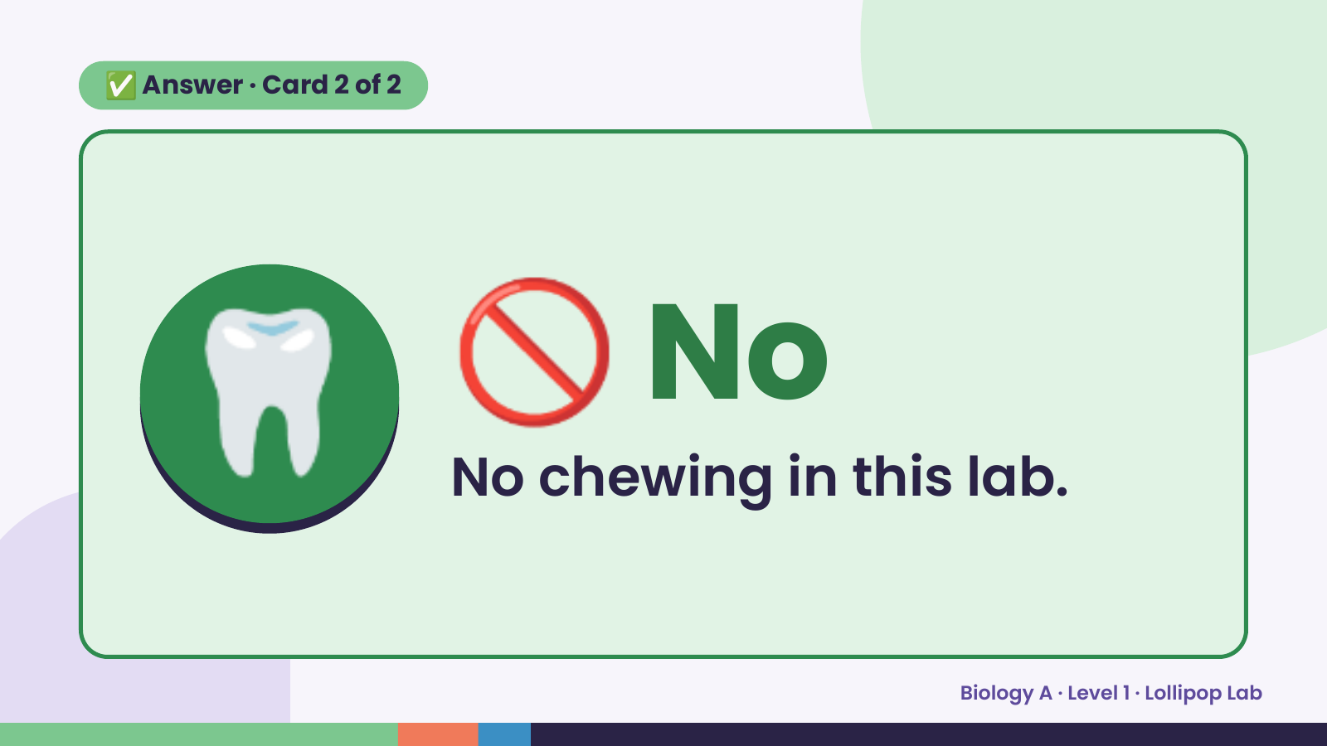
Notes:
✅ Answer · Card 2 of 2
🦷 🚫 No
No chewing in this lab.
Biology A · Level 1 · Lollipop Lab

Slide 10
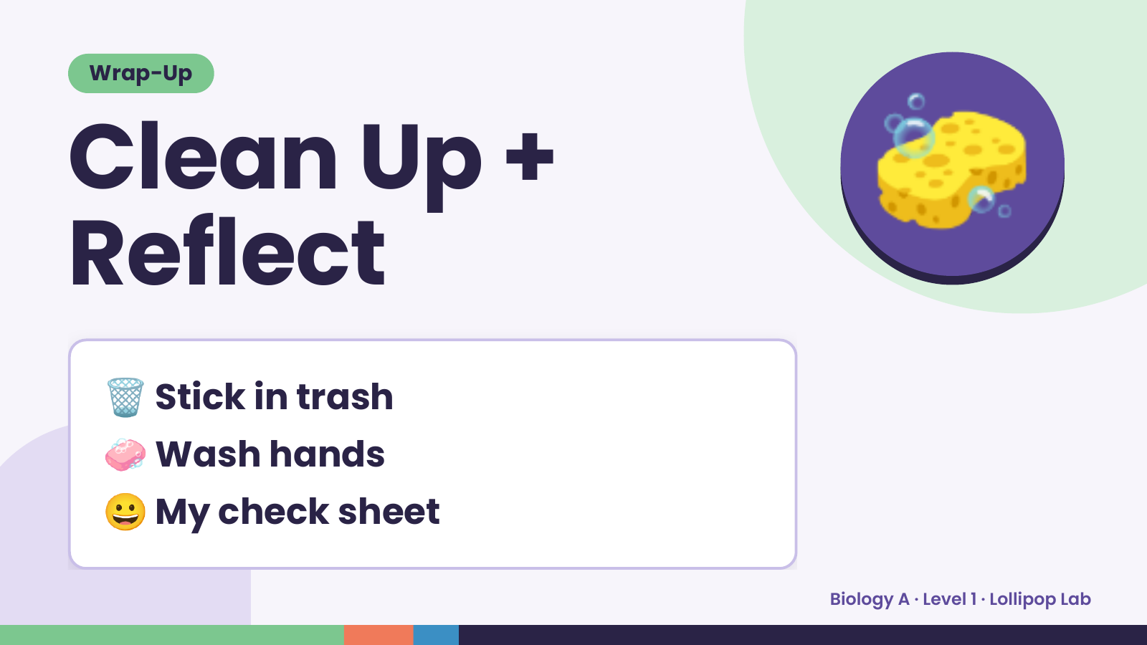
Notes:
Wrap-Up
Clean Up +
Reflect
🧽
🗑️ Stick in trash
🧼 Wash hands
😀 My check sheet
Biology A · Level 1 · Lollipop Lab

