Slide 1
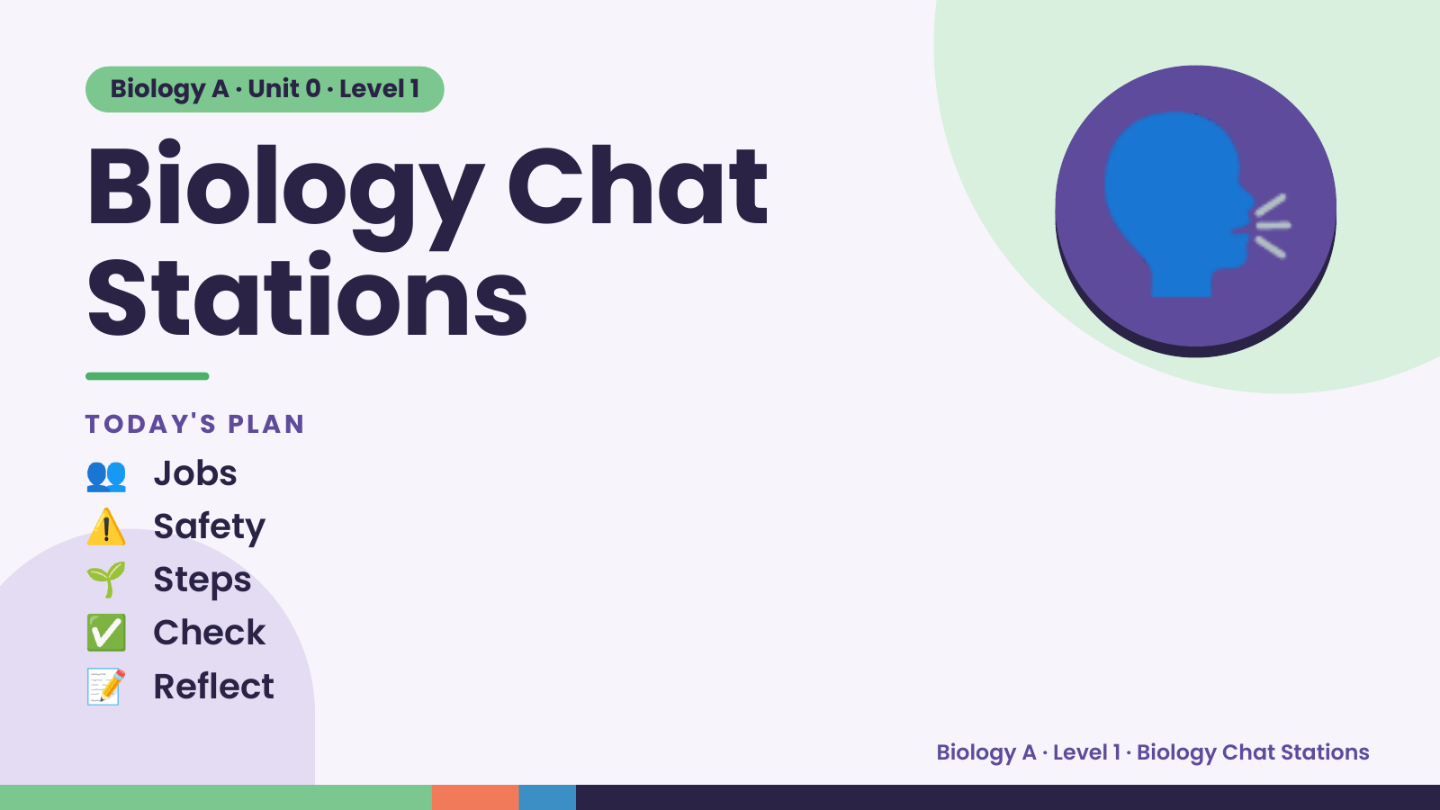
Notes:
Biology A · Unit 0 · Level 1
Biology Chat
Stations
TODAY'S PLAN
🗣️
👥 Jobs
⚠️ Safety
🌱 Steps
✅ Check
📝 Reflect
Biology A · Level 1 · Biology Chat Stations

Slide 2
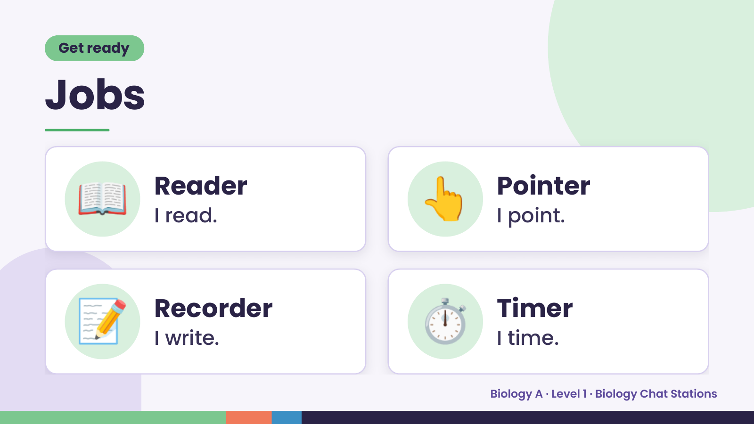
Notes:
Get ready
Jobs
📖 Reader
I read. 👆 Pointer
I point.
📝 Recorder
I write. ⏱️ Timer
I time.
Biology A · Level 1 · Biology Chat Stations

Slide 3
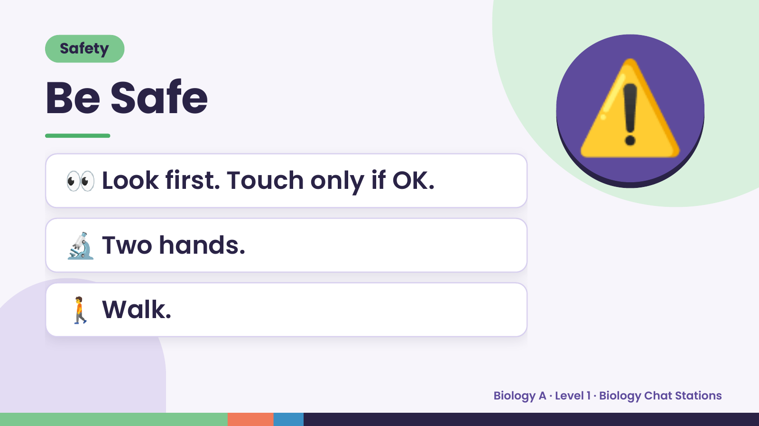
Notes:
Safety
Be Safe
👀 Look first. Touch only if OK.
⚠️
🔬 Two hands.
🚶 Walk.
Biology A · Level 1 · Biology Chat Stations

Slide 4
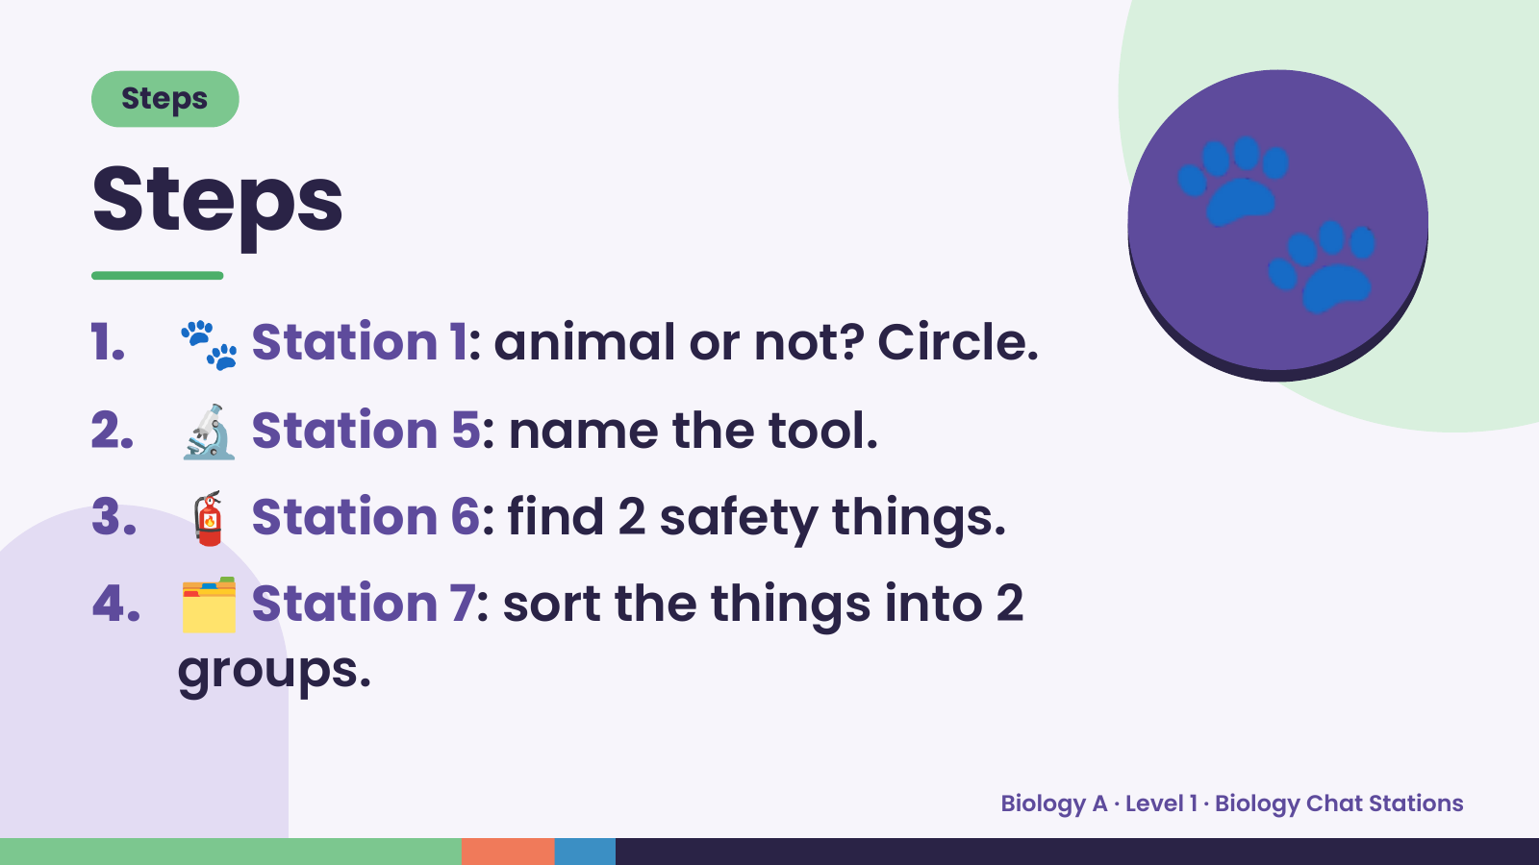
Notes:
Steps
Steps
1. 🐾 Station 1: animal or not? Circle.
2. 🔬 Station 5: name the tool.
🐾
3. 🧯 Station 6: find 2 safety things.
4. 🗂️ Station 7: sort the things into 2
groups.
Biology A · Level 1 · Biology Chat Stations

Slide 5
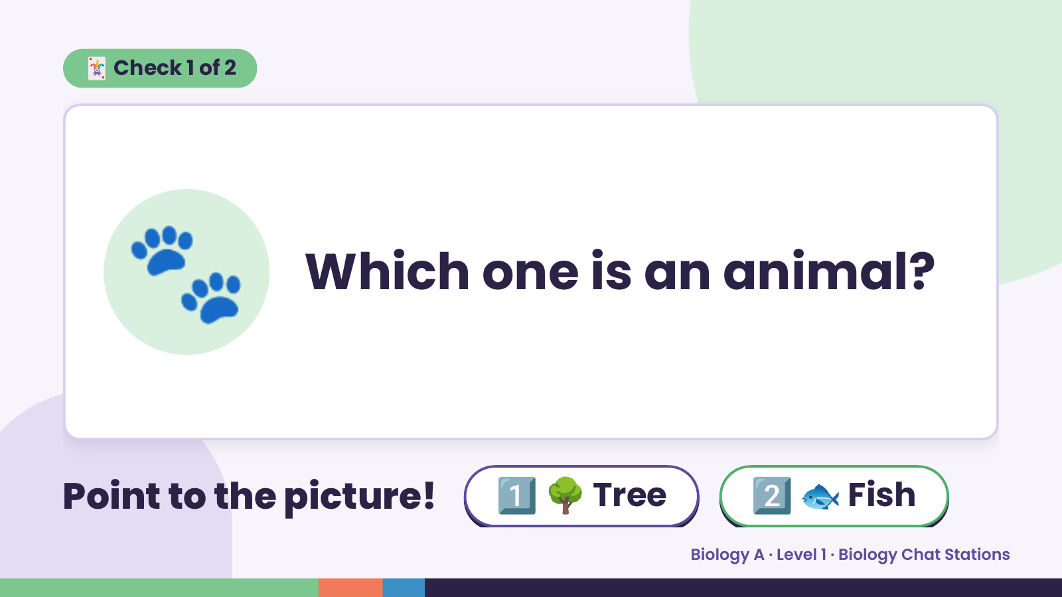
Notes:
🃏 Check 1 of 2
🐾 Which one is an animal?
Point to the picture! 1️⃣ 🌳 Tree 2️⃣ 🐟 Fish
Biology A · Level 1 · Biology Chat Stations

Slide 6
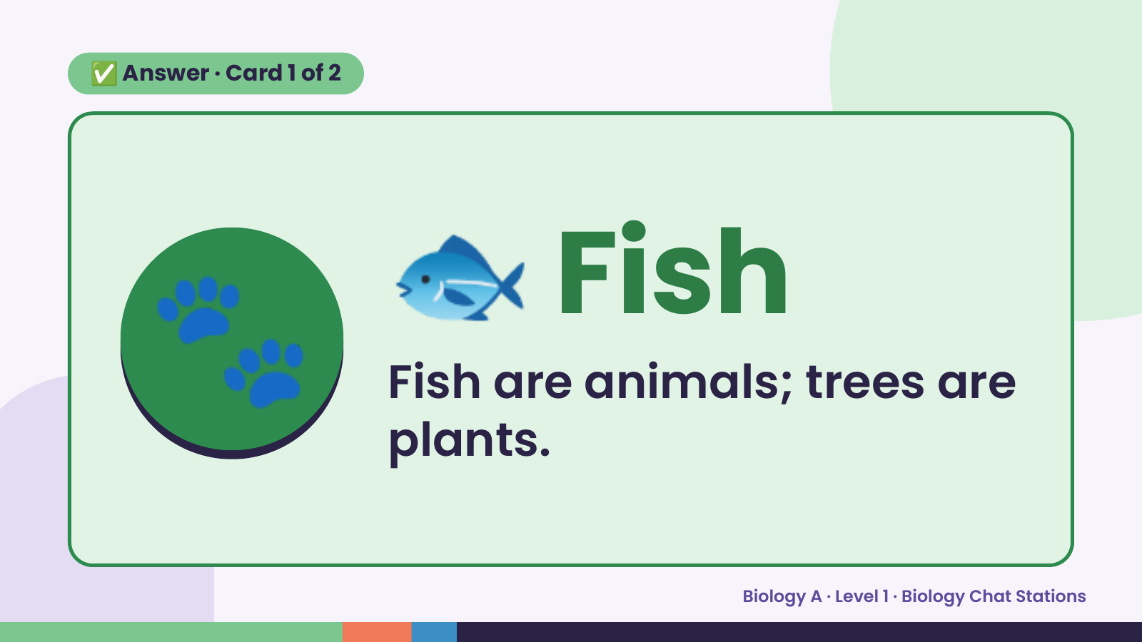
Notes:
✅ Answer · Card 1 of 2
🐾 🐟 Fish
Fish are animals; trees are
plants.
Biology A · Level 1 · Biology Chat Stations

Slide 7
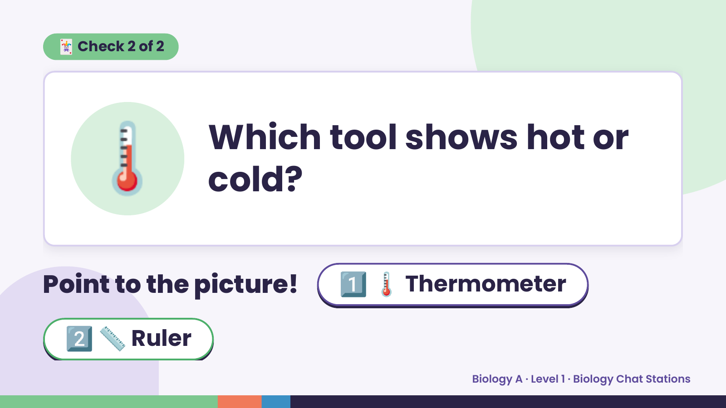
Notes:
🃏 Check 2 of 2
🌡️ Which tool shows hot or
cold?
Point to the picture! 1️⃣ 🌡️ Thermometer
2️⃣ 📏 Ruler
Biology A · Level 1 · Biology Chat Stations

Slide 8
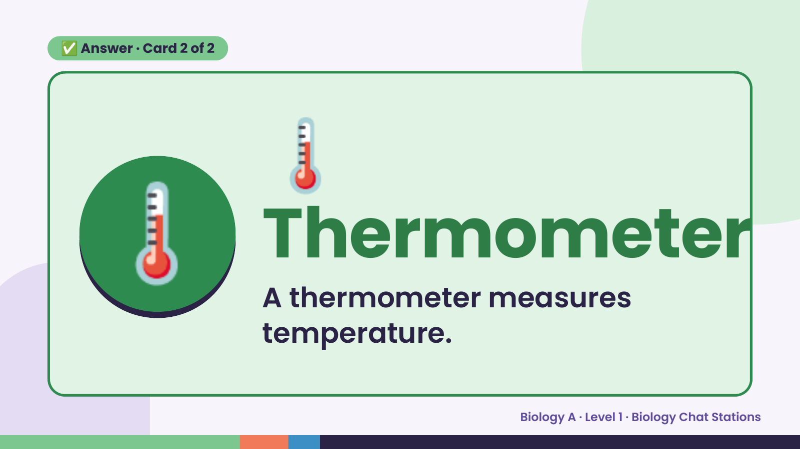
Notes:
🌡️
✅ Answer · Card 2 of 2
🌡️ Thermometer A thermometer measures
temperature.
Biology A · Level 1 · Biology Chat Stations

Slide 9
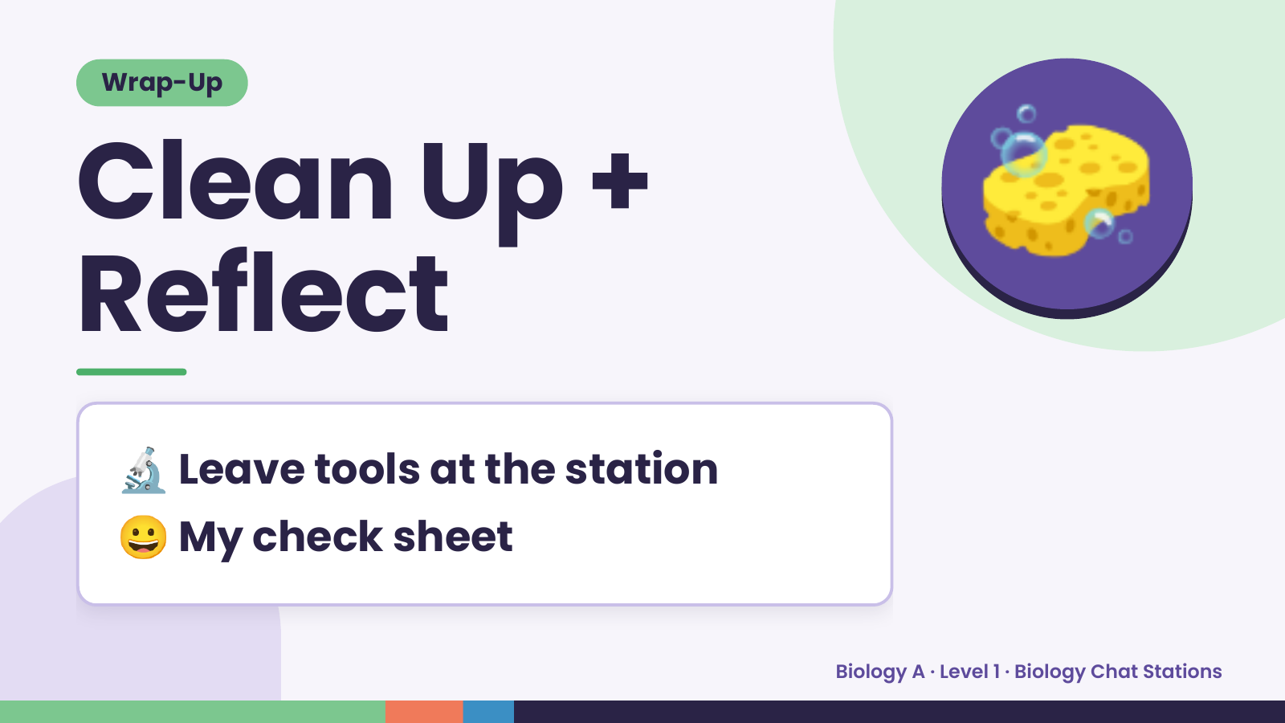
Notes:
Wrap-Up
Clean Up +
Reflect
🧽
🔬 Leave tools at the station
😀 My check sheet
Biology A · Level 1 · Biology Chat Stations

